Slide 1

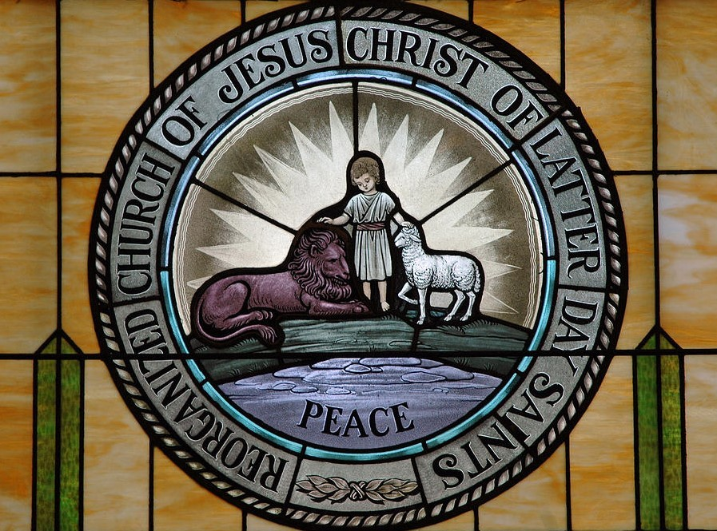
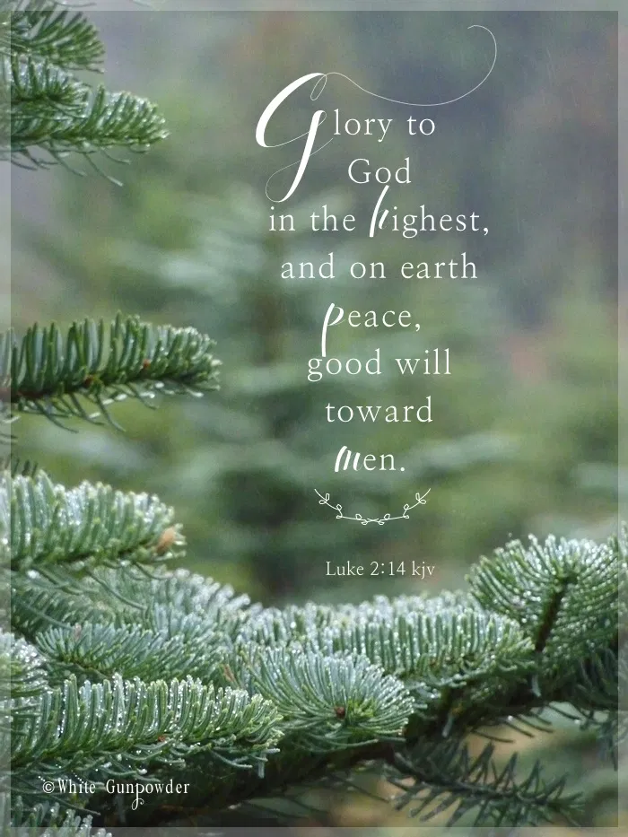
Part 2 of 4
Part 2

Slide 2
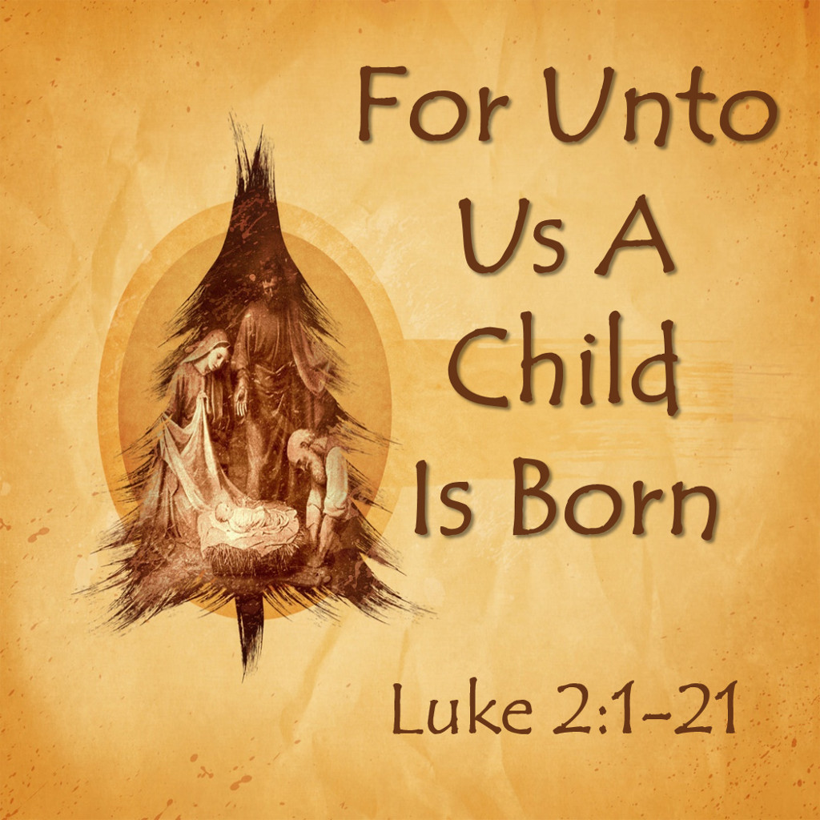
[2 Nephi 9:66-67]
For unto us a child is born, unto us a son is given: and the government shall be upon his shoulder: and his name shall be called Wonderful, Counselor, The mighty God, The everlasting Father,
The Prince of Peace.
Of the increase of government and peace there is no end, upon the throne of David, and upon his kingdom, to order it, and to establish it with judgment and with justice from henceforth even for ever. The zeal of the Lord of hosts will perform this.

Slide 3
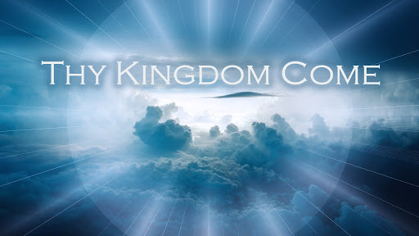

Slide 4
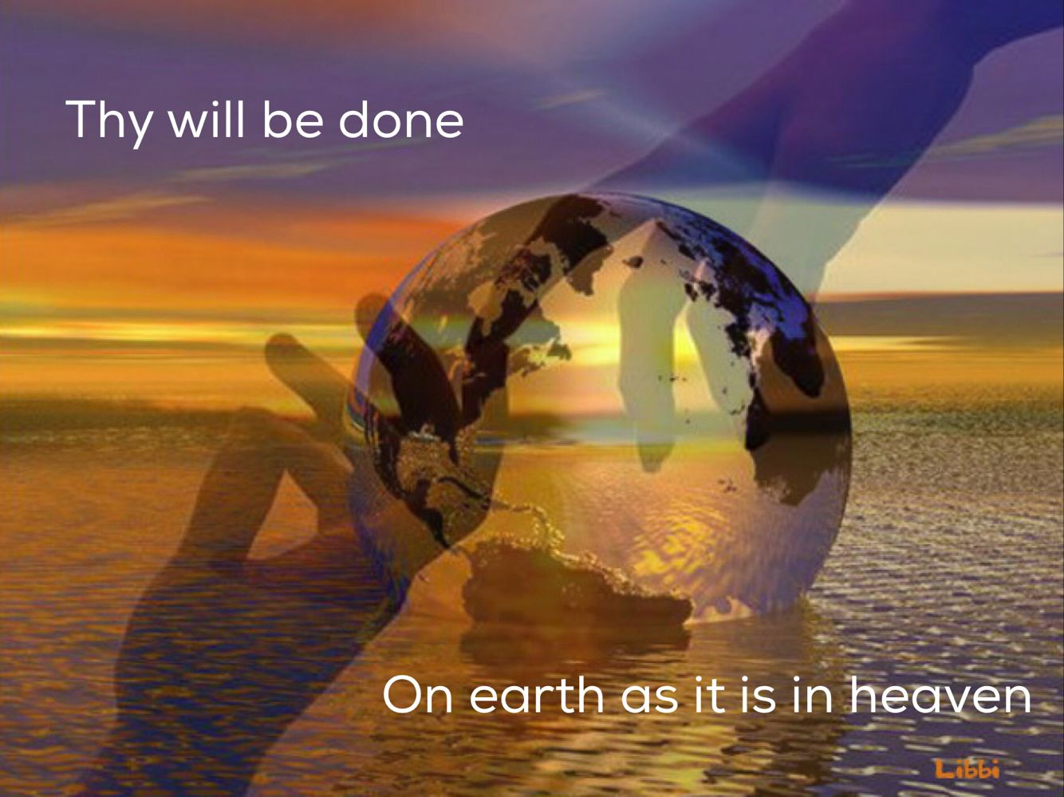

Slide 5
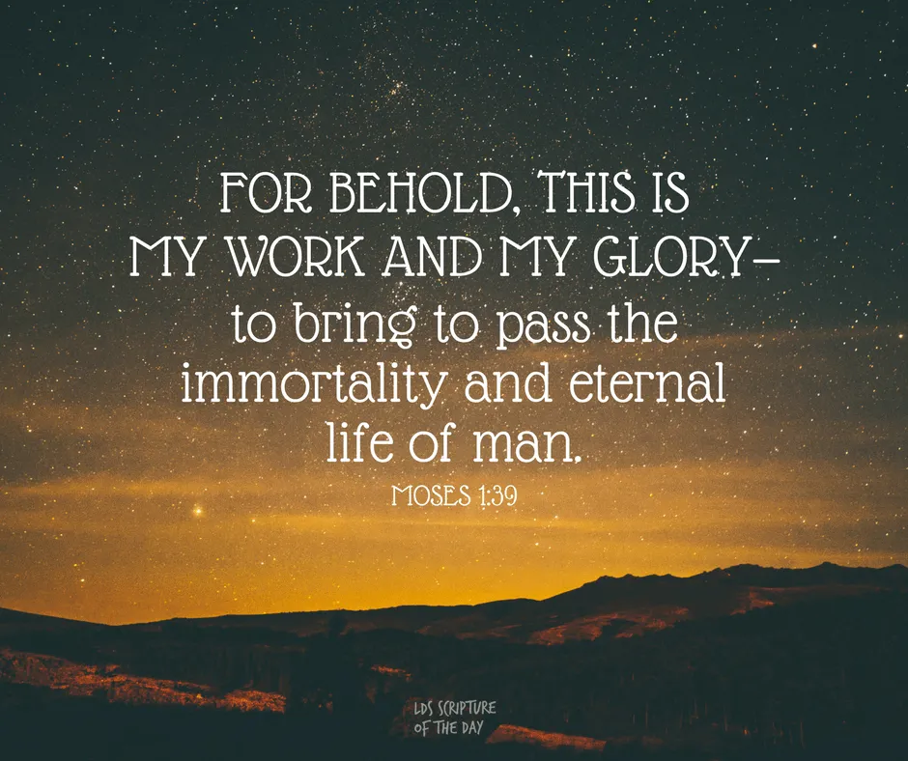

Slide 6
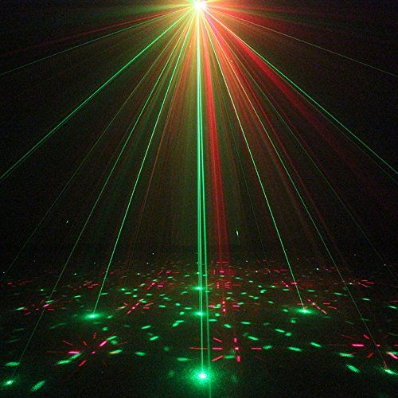
[Sec 85:1a-c]
Verily, thus saith the Lord unto you, who have assembled yourselves together to receive his will concerning you.
Behold, this is pleasing unto your Lord, and the angels rejoice over you; the alms of your prayers have come up into the ears of the Lord of Sabaoth, and are recorded in the book of the names of the sanctified, even them of the celestial world.
Wherefore I now send upon you another Comforter, even upon you, my friends, that it may abide in your hearts, even the Holy Spirit of promise, which other Comforter is the same that I promised unto my disciples, as is recorded in the testimony of John.

Slide 7

[Sec 85:2a-b]
This Comforter is the promise which I give unto you of eternal life, even the glory of the celestial kingdom; which glory is that of the church of the Firstborn, even of God, the holiest of all, through Jesus Christ, his Son;
he that ascended up on high, as also he descended below all things, in that he comprehended all things, that he might be in all and through all things, the light of truth, which truth shineth. This is the light of Christ.

Slide 8
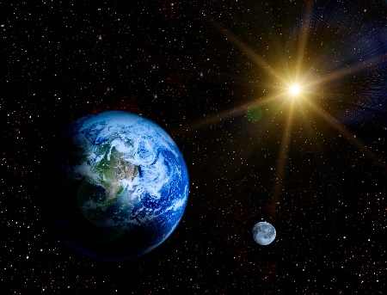
[Sec 85:2c-f]
As also he is in the sun, and the light of the sun, and the power thereof by which it was made.
As also he is in the moon, and is the light of the moon, and the power thereof by which it was made.
As also the light of the stars, and the power thereof by which they were made.
And the earth also, and the power thereof, even the earth upon which you stand.

Slide 9

[Sec 85:3a-b]
And the light which now shineth, which giveth you light, is through him who enlighteneth your eyes, which is the same light that quickeneth your understandings; which light proceedeth forth from the presence of God, to fill the immensity of space.
The light which is in all things; which giveth life to all things; which is the law by which all things are governed; even the power of God who sitteth upon his throne, who is in the bosom of eternity, who is in the midst of all things.

Slide 10

[Sec 85:4a-b]
Now, verily I say unto you, that through the redemption which is made for you, is brought to pass the resurrection from the dead. And the spirit and the body is the soul of man.
And the resurrection from the dead is the redemption of the soul; and the redemption of the soul is through him who quickeneth all things, in whose bosom it is decreed, that the poor and the meek of the earth shall inherit it.

Slide 11
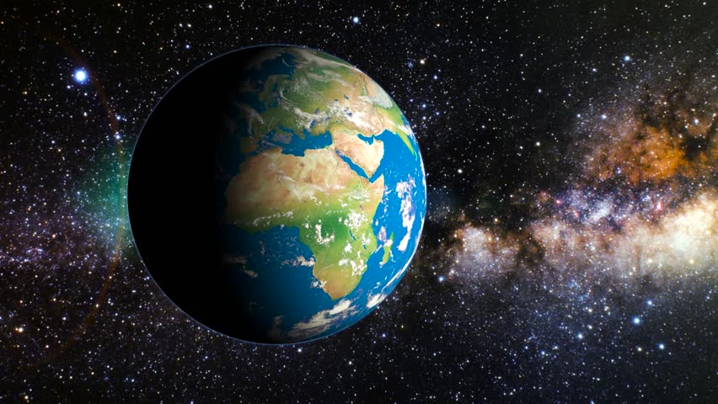
[Sec 85:4c-d]
Therefore, it [the earth] must needs be sanctified from all unrighteousness, that it may be prepared for the celestial glory; for after it hath filled the measure of its creation, it shall be crowned with glory, even with the presence of God the Father;
that bodies who are of the celestial kingdom may possess it for ever and ever; for, for this intent was it made and created; and for this intent are they sanctified.

Slide 12
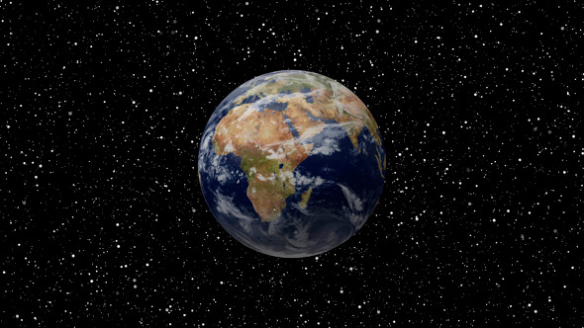
[Genesis 7:22-25]
And the Lord blessed the land, and they were blessed upon the mountains, and upon the high places, and did flourish.
And the Lord called his people, Zion, because they were of one heart and of one mind, and dwelt in righteousness; and there were no poor among them.
And Enoch continued his preaching in righteousness unto the people of God.
And it came to pass in his days, that he built a city that was called the city of Holiness, even Zion.

Slide 13
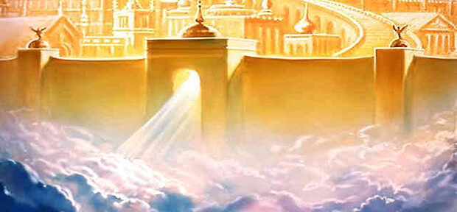
[Genesis 7:26-27]
And it came to pass, that Enoch talked with the Lord, and he said unto the Lord, Surely, Zion shall dwell in safety forever. But the Lord said unto Enoch, Zion have I blessed, but the residue of the people have I cursed.
And it came to pass, that the Lord showed unto Enoch all the inhabitants of the earth, and he beheld, and lo! Zion in process of time was taken up into heaven.

Slide 14
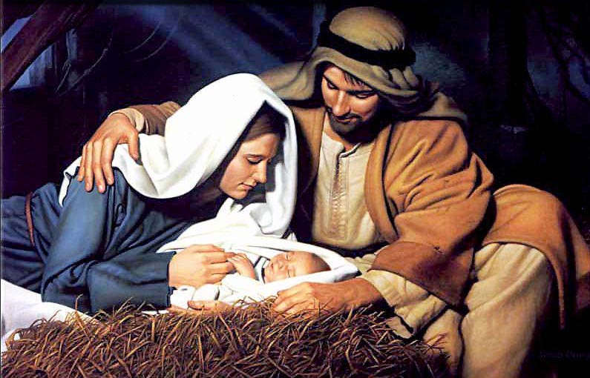
[Genesis 7:54]
And, behold, Enoch saw the day of the coming of the Son of Man, even in the flesh; and his soul rejoiced, saying, The righteous is lifted up; and the Lamb is slain from the foundation of the world; and through faith I am in the bosom of the Father; and behold, Zion is with me!

Slide 15
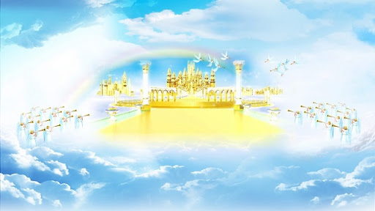
Genesis 7:70-72]
And righteousness and truth will I cause to sweep the earth as with a flood, to gather out mine own elect from the four quarters of the earth, unto a place which I shall prepare; an holy city, that my people may gird up their loins, and be looking forth for the time of my coming; for there shall be my tabernacle, and it shall be called Zion; a New Jerusalem.
And the Lord said unto Enoch, Then shalt thou and all thy city meet them there; and we will receive them into our bosom; and they shall see us, and we will fall upon their necks, and they shall fall upon our necks, and we will kiss each other;
And there shall be mine abode, and it shall be Zion, which shall come forth out of all the creations which I have made; and for the space of a thousand years shall the earth rest.

Slide 16
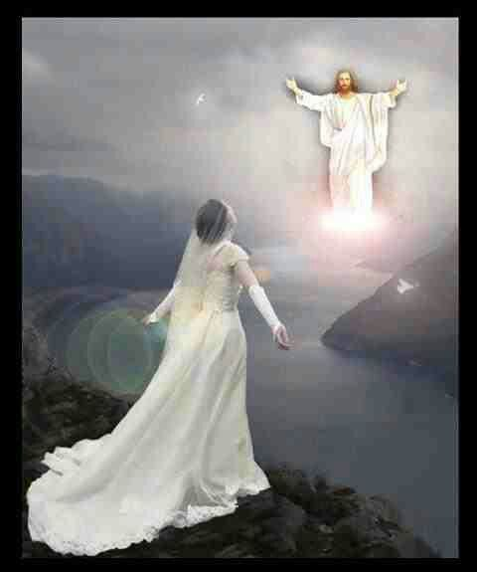
[Genesis 7:73]
And it came to pass, that Enoch saw the day of the coming of the Son of Man, in the last days, to dwell on the earth, in righteousness, for the space of a thousand years.
[Isaiah 9:6-7]
For unto us a child is born, unto us a son is given; and the government shall be upon his shoulder; and his name shall be called Wonderful, Counselor, The mighty God, The everlasting Father, The Prince of Peace.
Of the increase of his government and peace there is no end, upon the throne of David, and upon his kingdom, to order it, and to establish it with judgment and with justice from henceforth even forever. The zeal of the Lord of hosts will perform this.

Slide 17
Who is this Bride?
What does she have to do with Christmas and the birth of Jesus Christ?

Slide 18
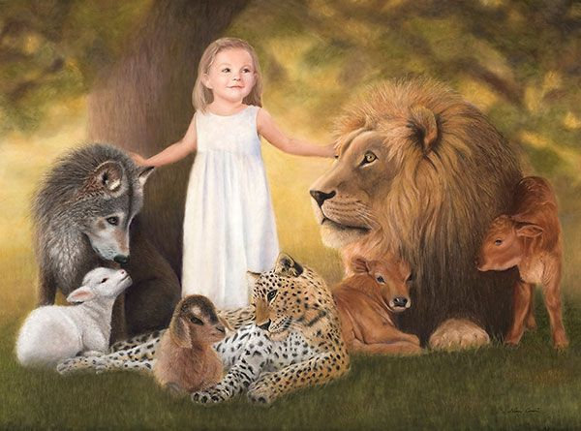
[Isaiah 11:6]
The wolf also shall dwell with the lamb, and the leopard shall lie down with the kid; and the calf and the young lion and the fatling together; and a little child shall lead them.

Slide 19
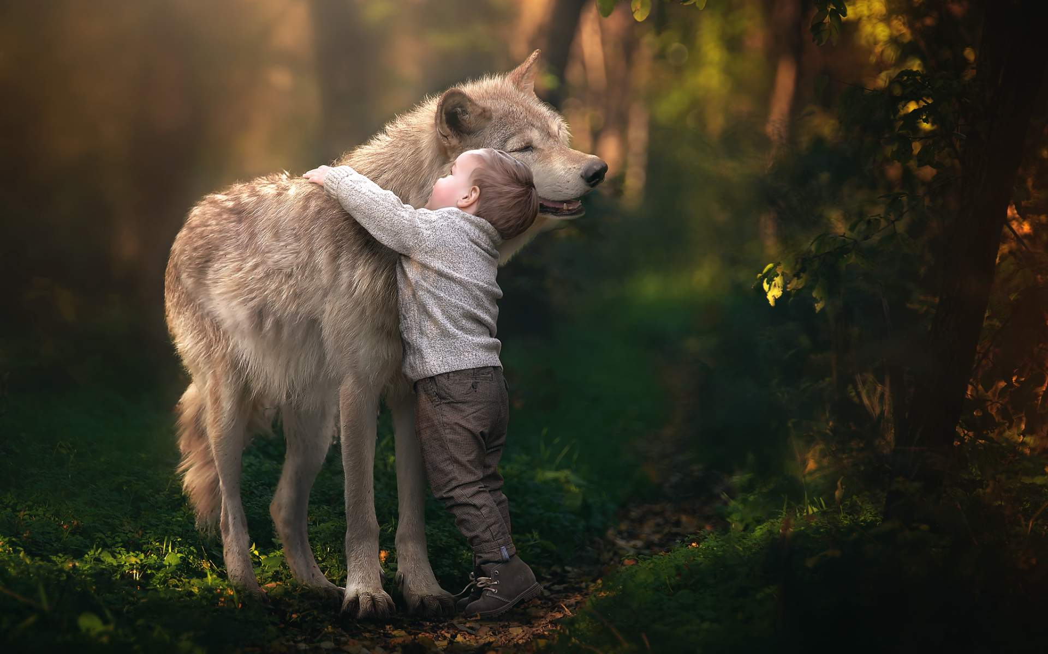
[Isaiah 11:9]
They shall not hurt nor destroy in all my holy mountain; for the earth shall be full of the knowledge of the Lord, as the waters cover the sea.

Slide 20
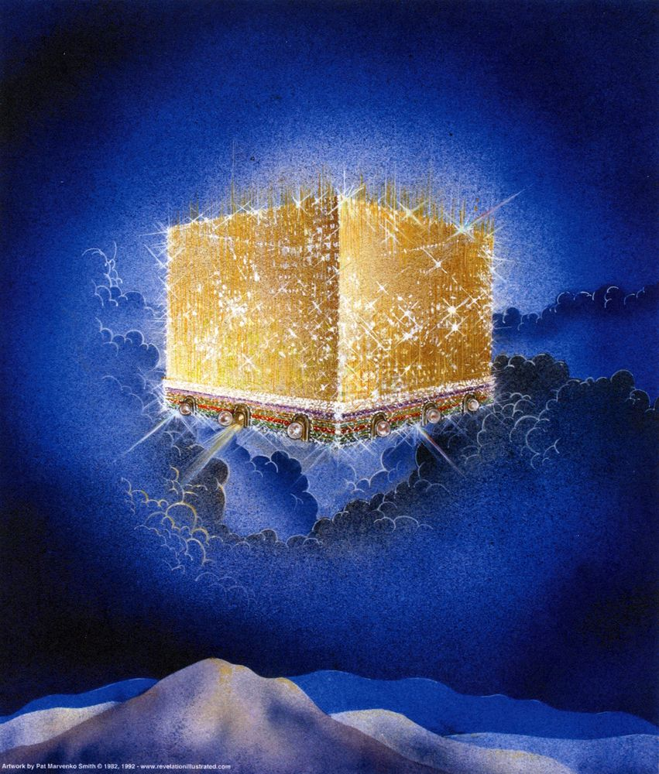
[Revelation 21:2-4]
And I John saw the holy city, new Jerusalem, coming down from God out of heaven, prepared as a bride adorned for her husband.
And I heard a great voice out of heaven saying, Behold, the tabernacle of God is with men, and he will dwell with them, and they shall be his people, and God himself shall be with them, and be their God.
And God shall wipe away all tears from their eyes; and there shall be no more death, neither sorrow, nor crying, neither shall there be any more pain; for the former things are passed away.

Slide 21
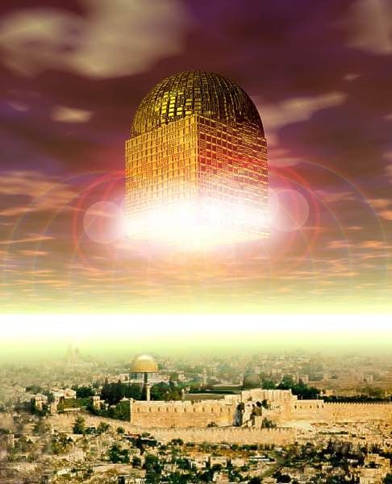
[Revelation 21:9-10]
And there came unto me one of the seven angels which had the seven last plagues, and talked with me, saying, Come hither, I will show thee
the bride, the Lamb's wife.
And he carried me away in the Spirit to a great and high mountain, and showed me that great city, the
holy Jerusalem,
descending out of heaven from God,

Slide 22

[Sec 65:1a-c]
Hearken, and lo, a voice as of one sent down from on high, who is mighty and powerful, whose going forth is unto the ends of the earth; yea, whose voice is unto men, Prepare ye the way of the Lord, make his paths straight.
The keys of the kingdom of God are committed unto man on the earth, and from thence shall the gospel roll forth unto the ends of the earth, as the stone which is cut out of the mountain without hands shall roll forth, until it has filled the whole earth;
yea, a voice crying, Prepare ye the way of the Lord, prepare ye the supper of the Lamb, make ready for the Bridegroom;

Slide 23
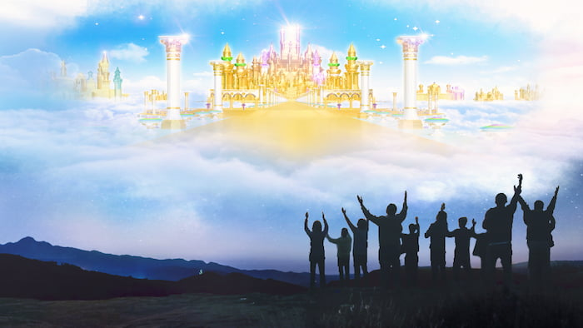
[Sec 65:1d-f]
pray unto the Lord; call upon his holy name; make known his wonderful works among the people, call upon the Lord, that his kingdom may go forth upon the earth;
that the inhabitants thereof may receive it, and be prepared for the days to come, in the which the Son of man shall come down in heaven, clothed in the brightness of his glory, to meet the kingdom of God which is set up on the earth;
wherefore, may the kingdom of God go forth, that the kingdom of heaven may come, that thou, O God, may be glorified in heaven, so on earth, that thy enemies may be subdued; for thine is the honor, power, and glory, for ever and ever. Amen.

Slide 24
See Part 3 of 4
Part 2

