Slide 1
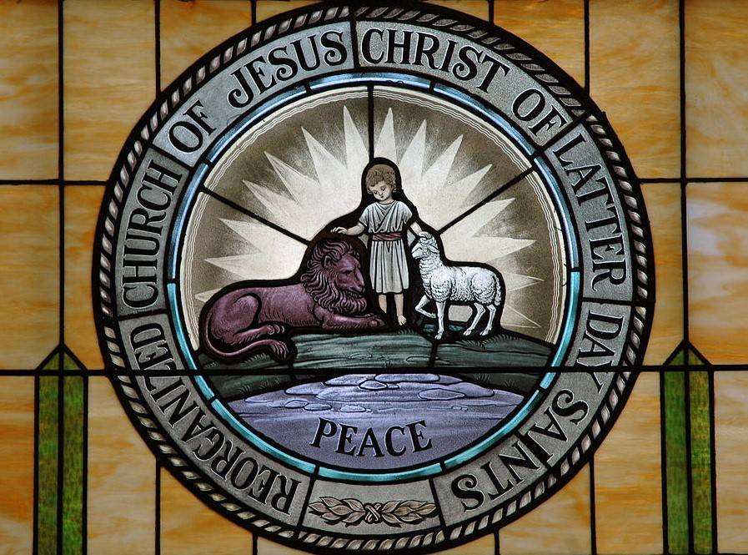
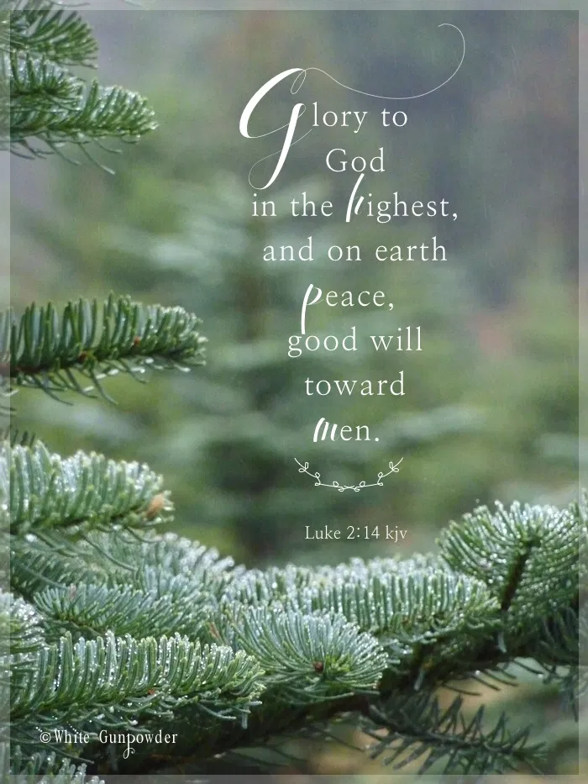
Part 1 of 4

Slide 2
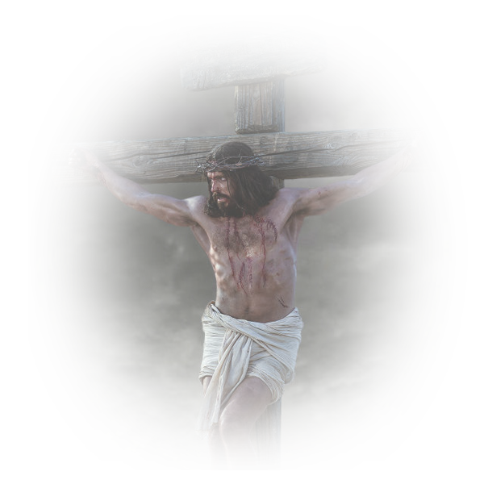
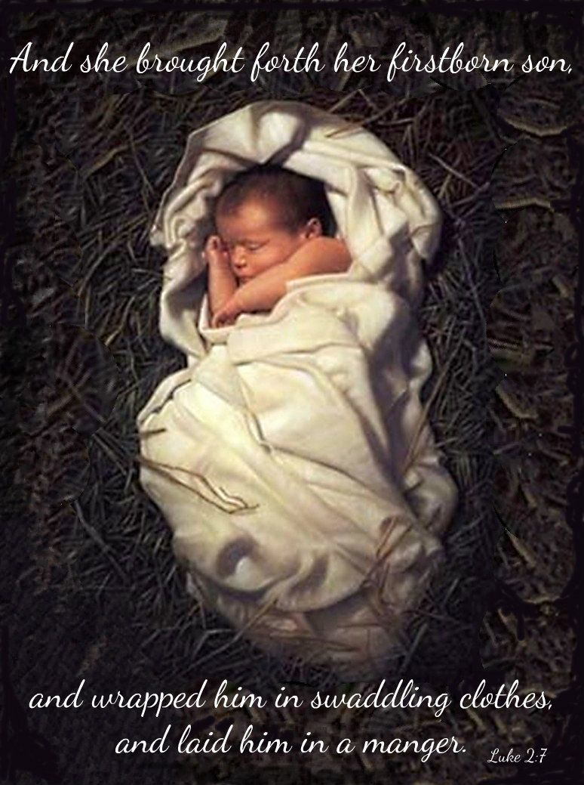
For God so loved the world, that he gave his Only Begotten Son, that whosoever believeth on him should not perish; but have everlasting life. [John 3:16]

Slide 3
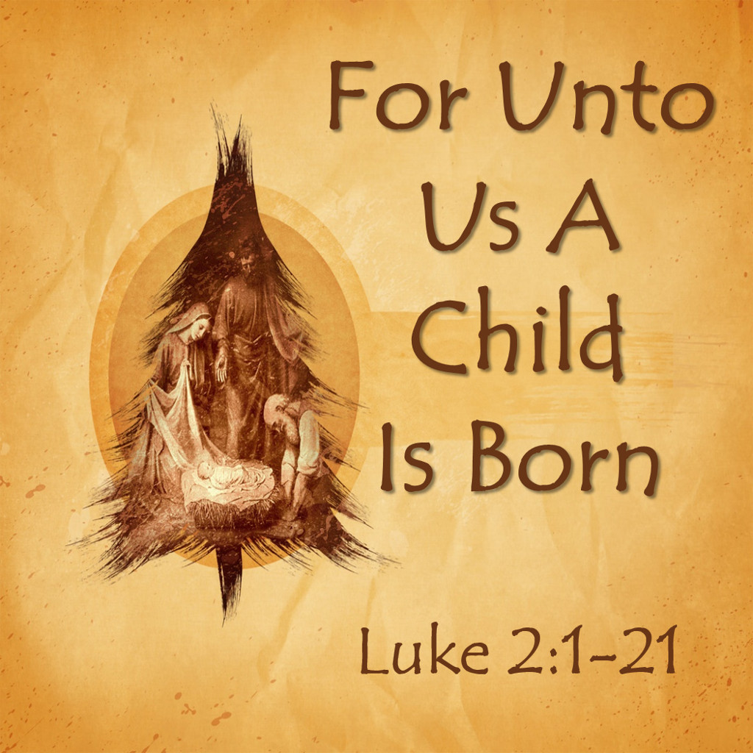
[2 Nephi 9:66-67]
For unto us a child is born, unto us a son is given: and the government shall be upon his shoulder: and his name shall be called Wonderful, Counselor, The mighty God, The everlasting Father,
The Prince of Peace.
Of the increase of government and peace there is no end, upon the throne of David, and upon his kingdom, to order it, and to establish it with judgment and with justice from henceforth even for ever. The zeal of the Lord of hosts will perform this.

Slide 4
Luke 2:14

Slide 5
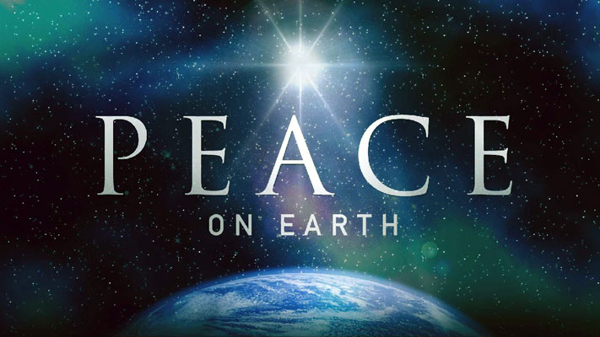
There is no better time than now, right now, this very Christmas season, for all of us to rededicate ourselves to the principles taught by Jesus Christ.
Peace on Earth!

Slide 6
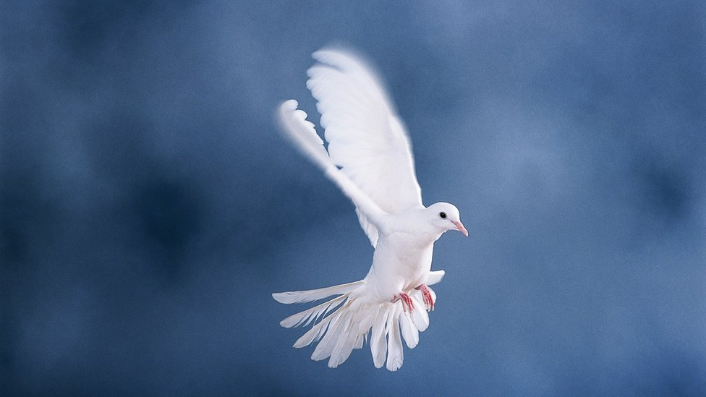
[Mosiah 11:207]
And how blessed
are they!
For they did publish peace; they did publish good tidings of good; and they did declare unto the people that the Lord reigneth.

Slide 7
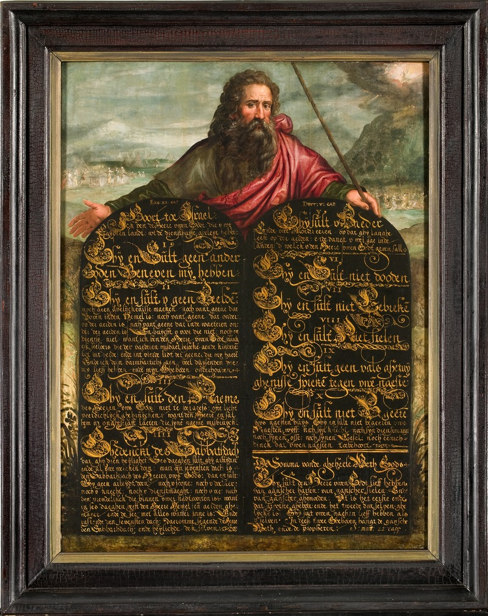
What are these principles?
Want peace on earth?
Know and keep the TEN COMMANDMENTS

Slide 8
Want peace on earth?
The birth of Jesus Christ and the celebration, Christmas, is to think of the
Six Principles of the
Doctrine of Christ
The foundation of His Church
The building blocks
The knowledge
The understanding
The wisdom
Revelatory truth

Slide 9
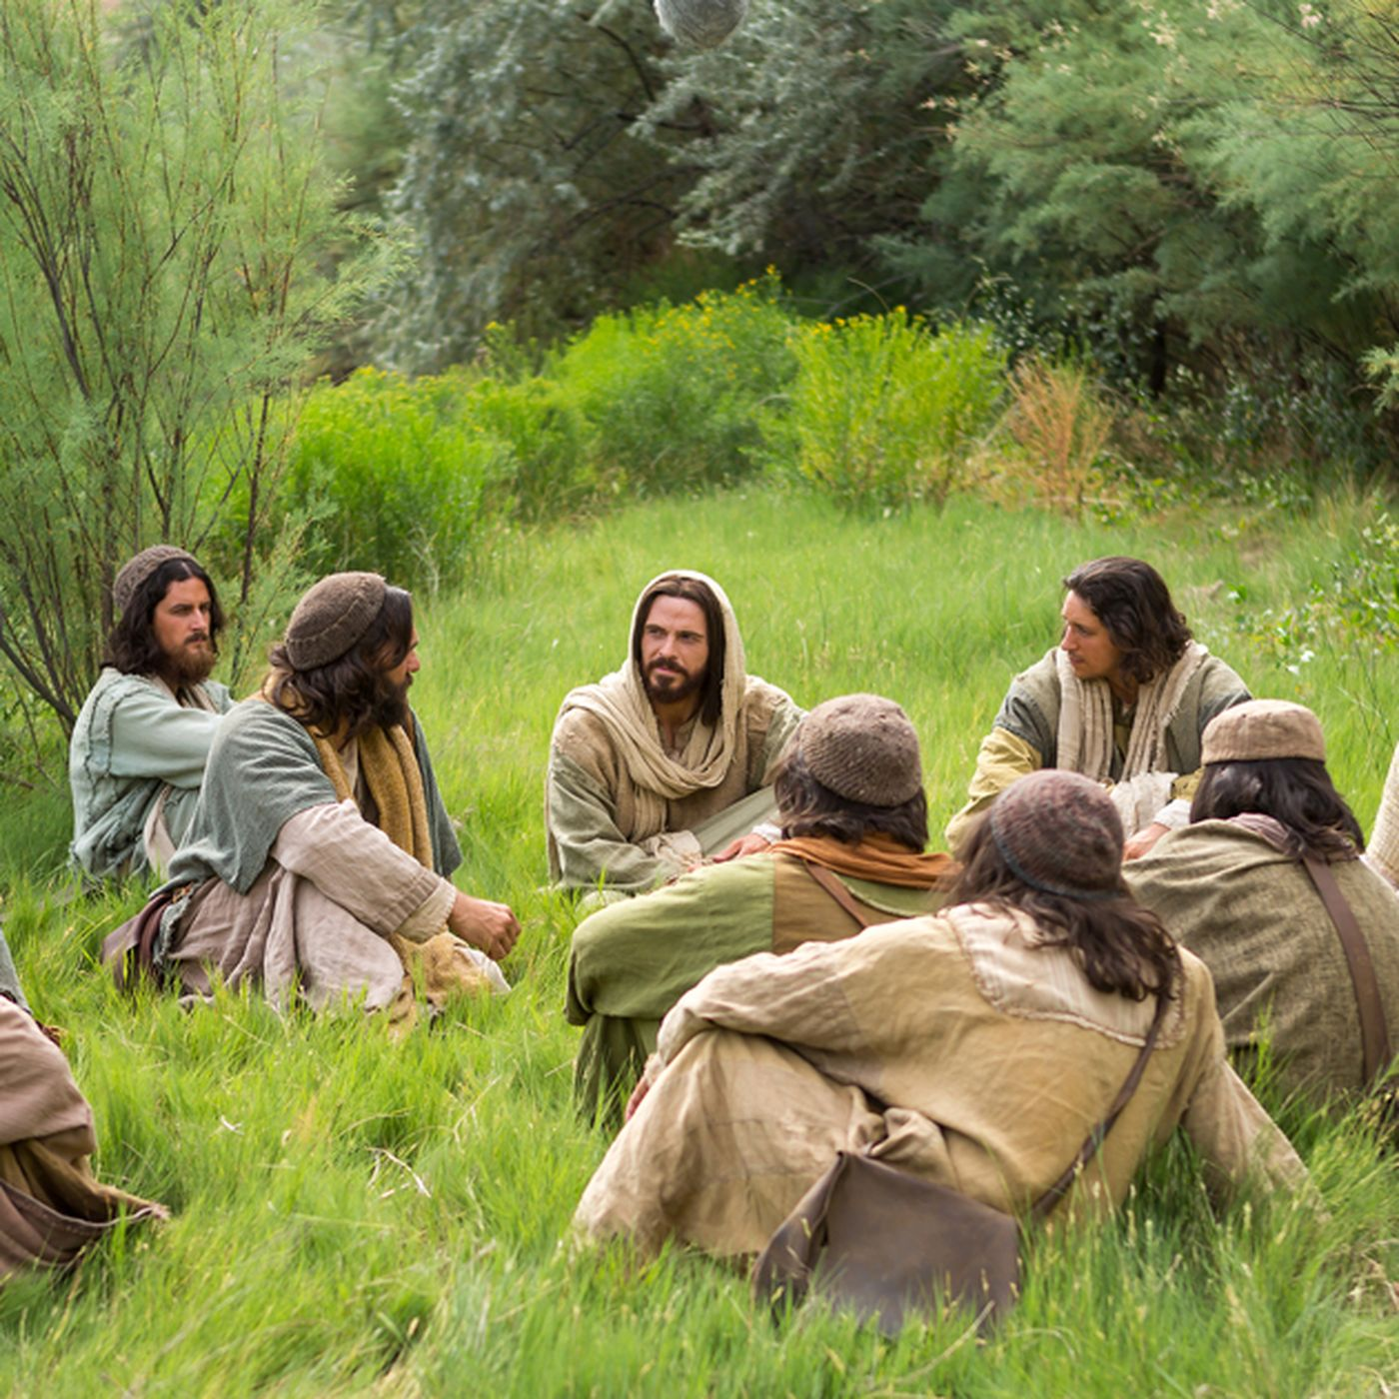
[Matthew 16:14-19]
And Jesus asked his disciples, saying, Whom do men say that I, the Son of Man, am?
And Simon Peter answered and said, Thou art the Christ, the Son of the living God.
And Jesus answered and said, for flesh and blood hath not revealed this unto thee, but my Father who is in heaven.
And I say also unto thee, upon this rock I will build my church, and the gates of hell shall not prevail against it.
This is the Spirit of Christmas!

Slide 10
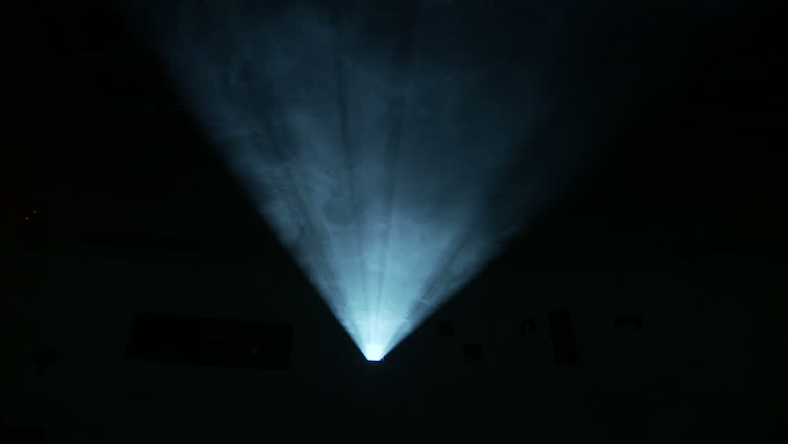
[Matthew 5:2]
And he opened his mouth, and taught them, saying,
[Matthew 5:3]
Blessed are they who shall believe on me; and again, more blessed are they who shall believe on your words, when ye shall testify that ye have seen me and that I am.
[Matthew 5:4]
Yea, blessed are they who shall believe on your words, and come down into the depth of humility, and be baptized in my name; for they shall be visited with fire and the Holy Ghost, and shall receive a remission of their sins.

Slide 11
[Matthew 5:5]
Yea, blessed are the poor in spirit, who come unto me; for theirs is the kingdom of heaven.
[Matthew 5:6]
And again, blessed are they that mourn; for they shall be comforted.
[Matthew 5:7]
And blessed are the meek; for they shall inherit the earth.

Slide 12
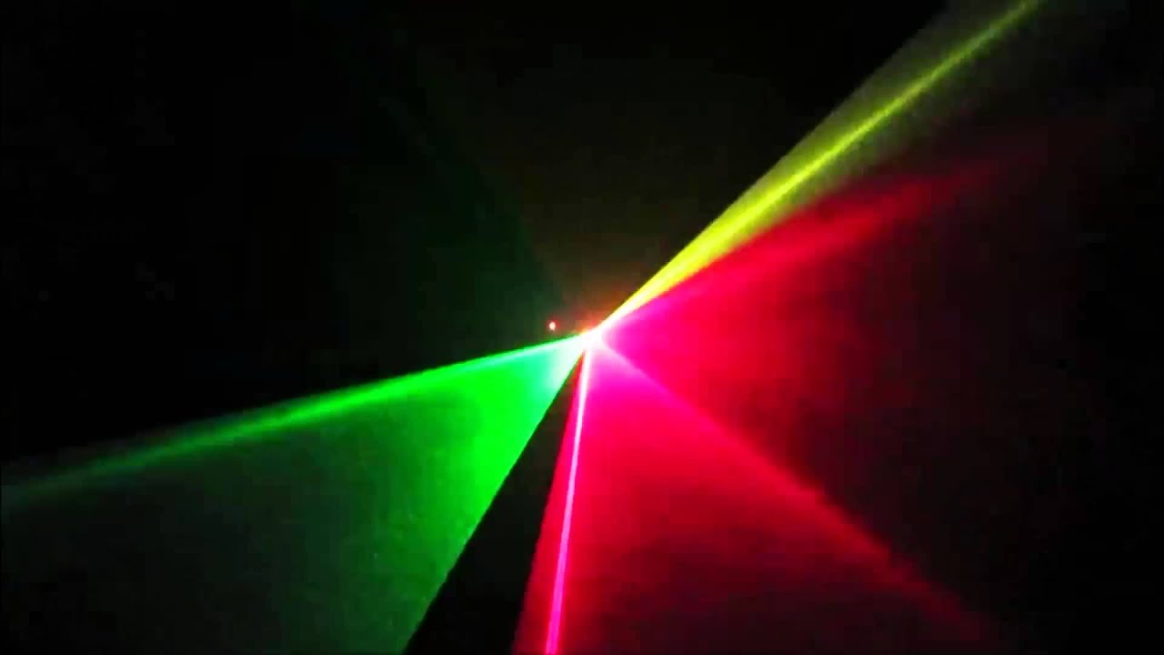
[Matthew 5:8]
And blessed are all they that do hunger and thirst after righteousness; for they shall be filled with the Holy Ghost.
[Matthew 5:9]
And blessed are the merciful; for they shall obtain mercy.
[Matthew 5:10]
And blessed are all the pure in heart; for they shall see God.

Slide 13
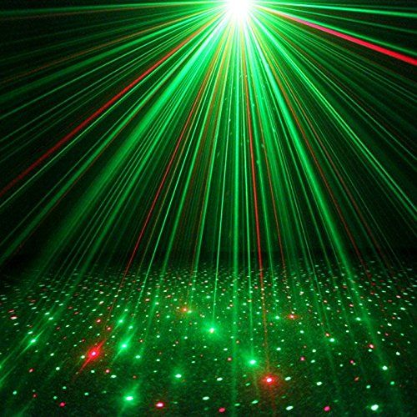
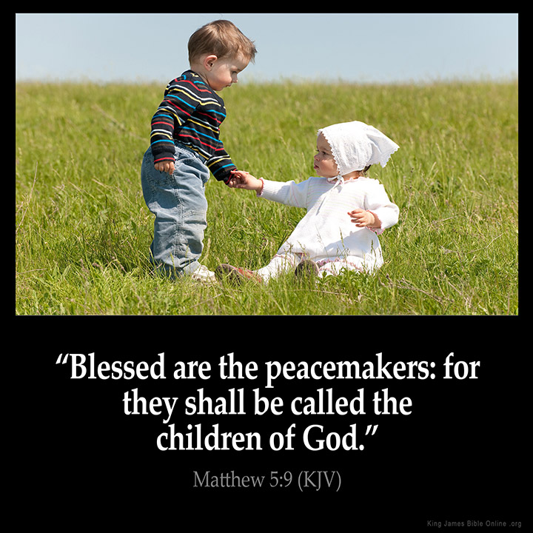
[Matthew 5:11]
And blessed are all the peacemakers; for they shall be called the children of God.

Slide 14
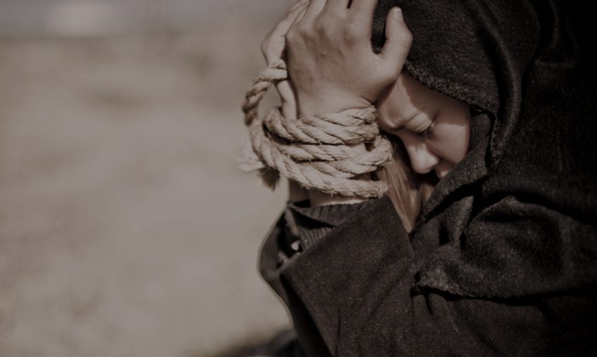
[Matthew 5:12]
Blessed are all they that are persecuted for my name's sake; for theirs is the kingdom of heaven.

Slide 15
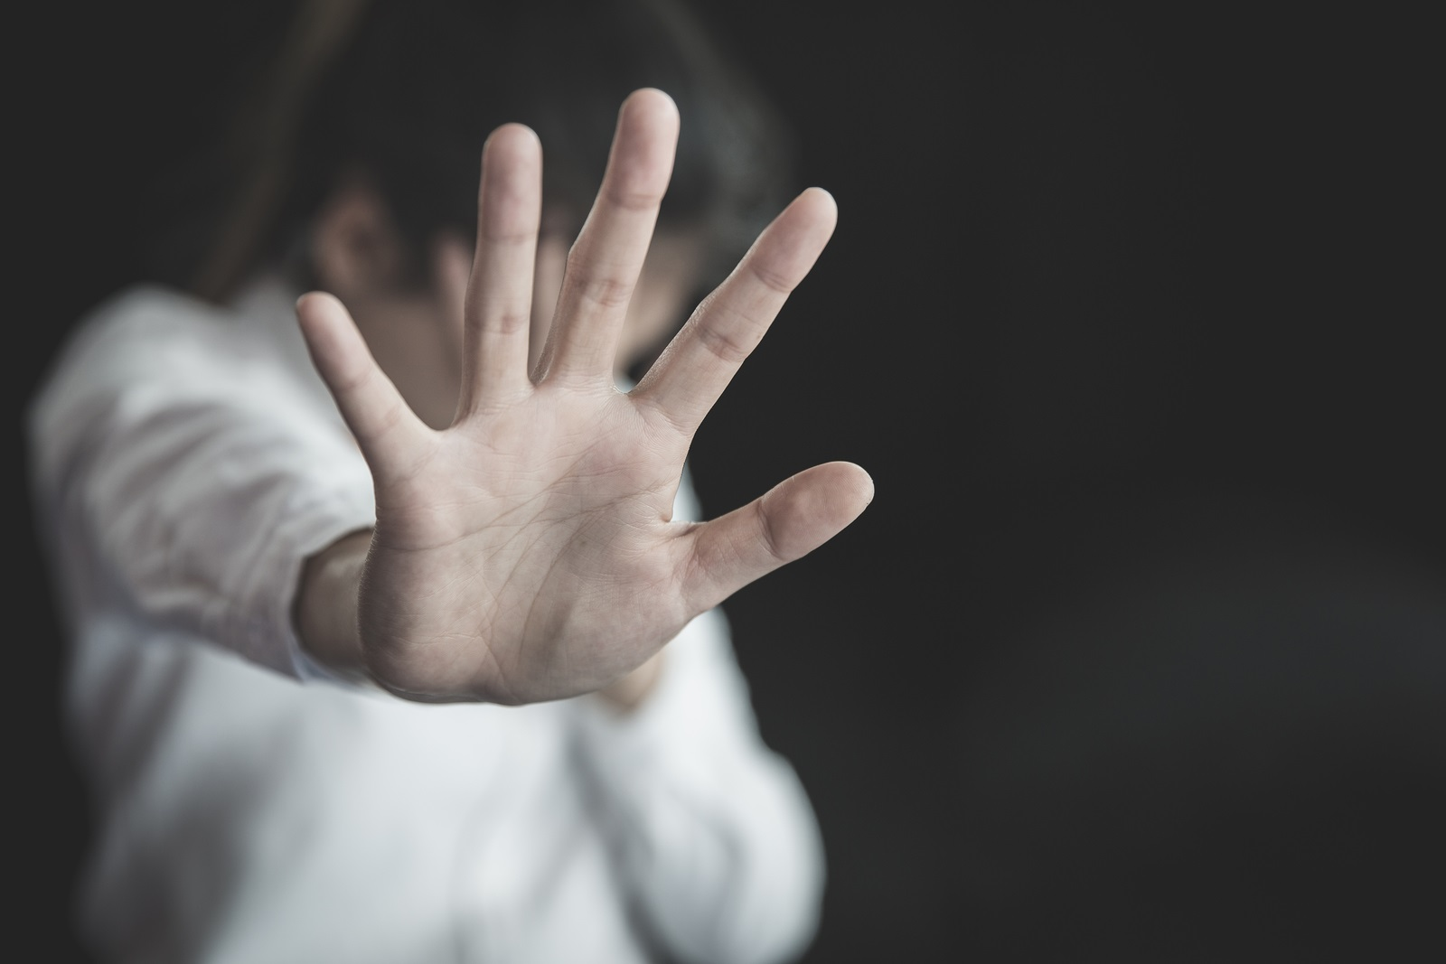
[Matthew 5:13]
And blessed are ye when men shall revile you, and persecute you, and shall say all manner of evil against you falsely, for my sake.

Slide 16
[Matthew 5:14]
For ye shall have great joy, and be exceeding glad; for great shall be your reward in heaven; for so persecuted they the prophets which were before you.

Slide 17
See Part 2 of 4

