Slide 1
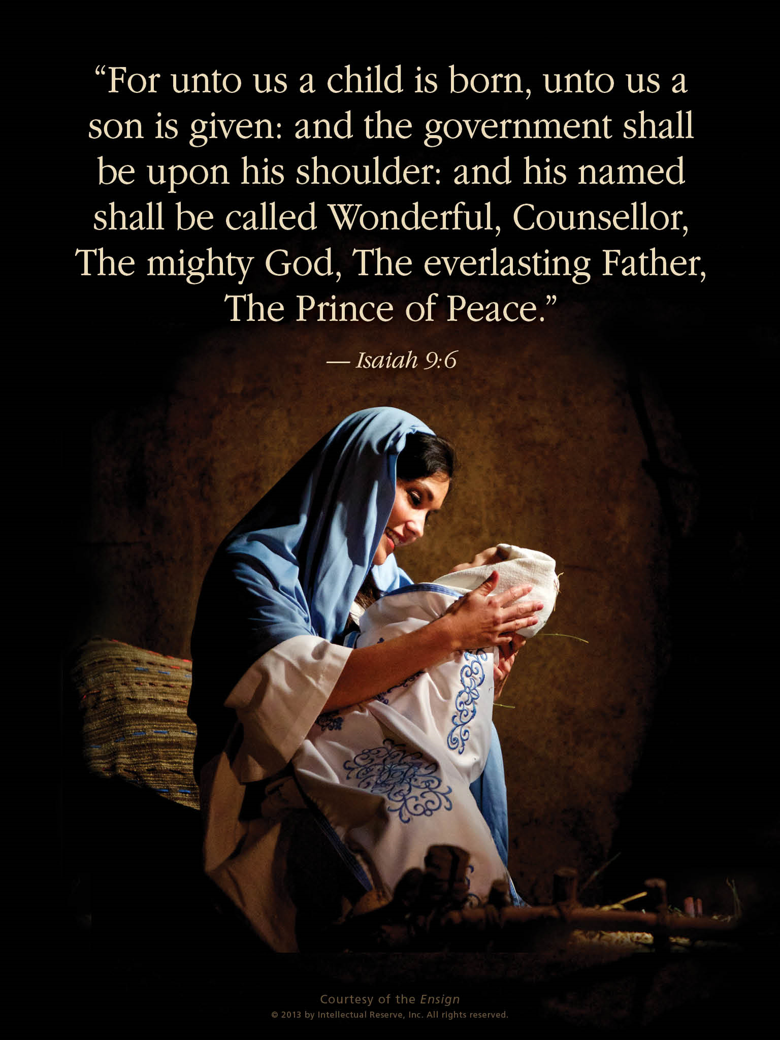
Keep
Christ
in Christmas
By Seventy
James L. Noland

Slide 2
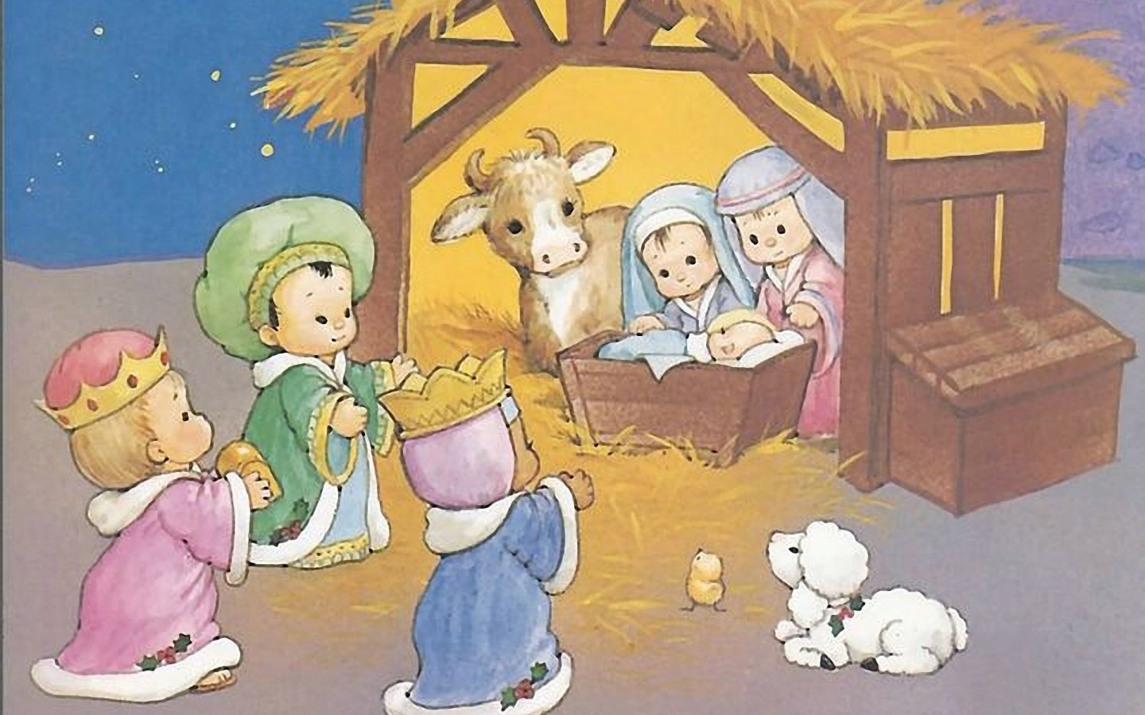

Slide 3
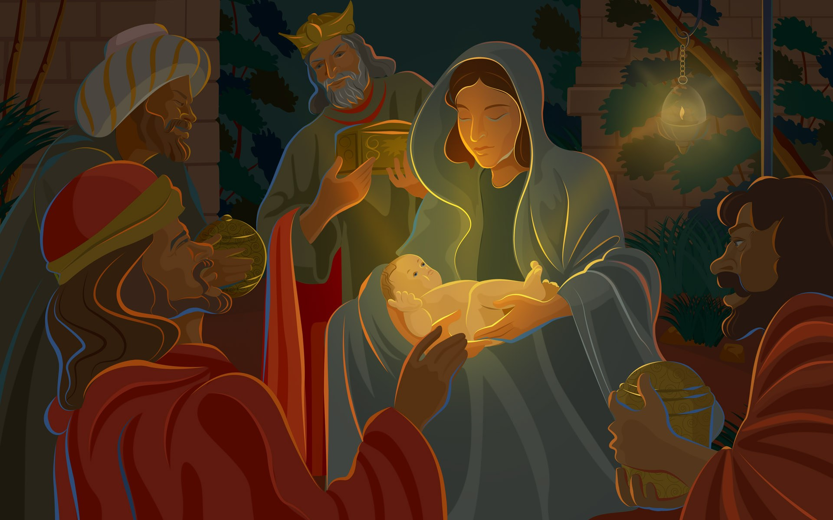
Wise: Properly, having knowledge; hence, having the power of discerning and judging correctly, or of discriminating between what is true and what is false.
Now, as it is written, the birth of Jesus Christ was on this wise. [Matthew 2:1]

Slide 4
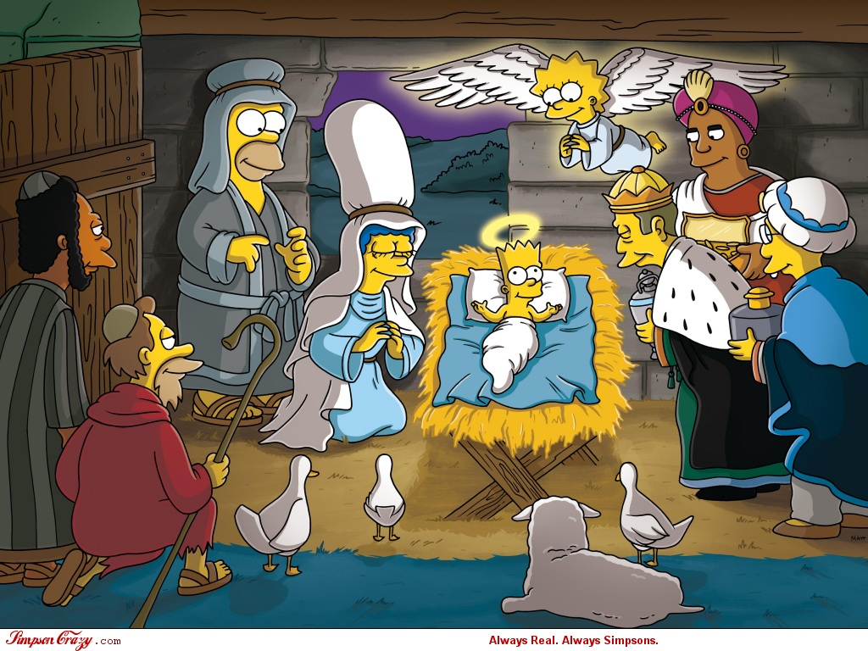
What has happened to the story of the birth of Christ?

Slide 5
For the time will come when they will not endure sound doctrine; but after their own lusts shall they heap to themselves teachers, having itching ears;
And they shall turn away their ears from the truth, and [the truth] shall be turned unto fables.
[2 Timothy 4:3-4]
FABLE, v.i.
1. To feign; to write fiction.
Vain now the tales which fabling poets tell.
2. To tell falsehoods.

Slide 6
Most modern liberal theologians have generally rejected the virgin birth. They regard it as a religious myth that was added to Christian belief in the late first century AD and was triggered by a Greek mistranslation of the book of Isaiah from the original Hebrew.
Its purpose was to make Christianity more competitive with contemporary Pagan religions in the Mediterranean region, most of whom featured their founder having being born of a virgin. Without the claim of a virgin birth, it is unclear whether Christianity could have survived.
Religious Tolerance.org
According to academia, there are at least 32 stories of other virgin births in ancient cultures of bygone eras. www.lawofattractiongps.com

Slide 7
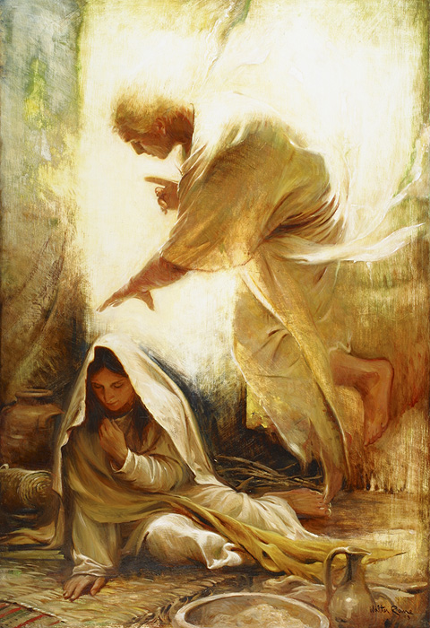
And in the sixth month the angel Gabriel was sent from God, unto a city of Galilee, named Nazareth.
To a virgin, espoused to a man whose name was Joseph, of the house of David; and the virgin's name was Mary.

Slide 8
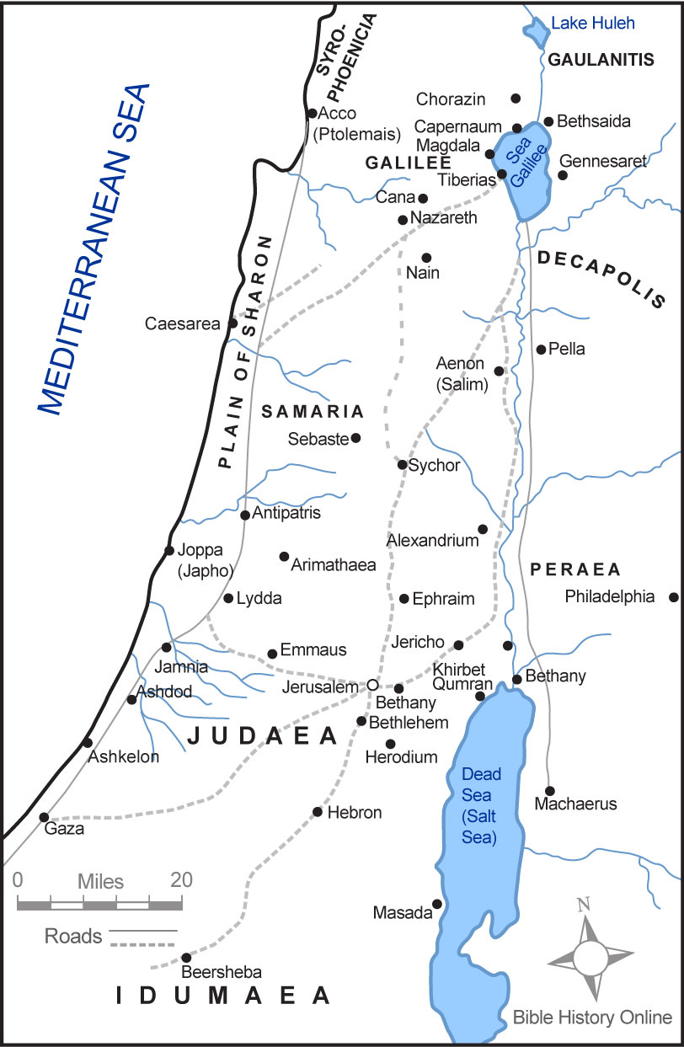
69 miles

Slide 9
And the angel came in unto her and said, Hail, thou virgin, who art highly favored of the Lord. The Lord is with thee, for thou art chosen and blessed among women. [Luke 1:26-28]

Slide 10
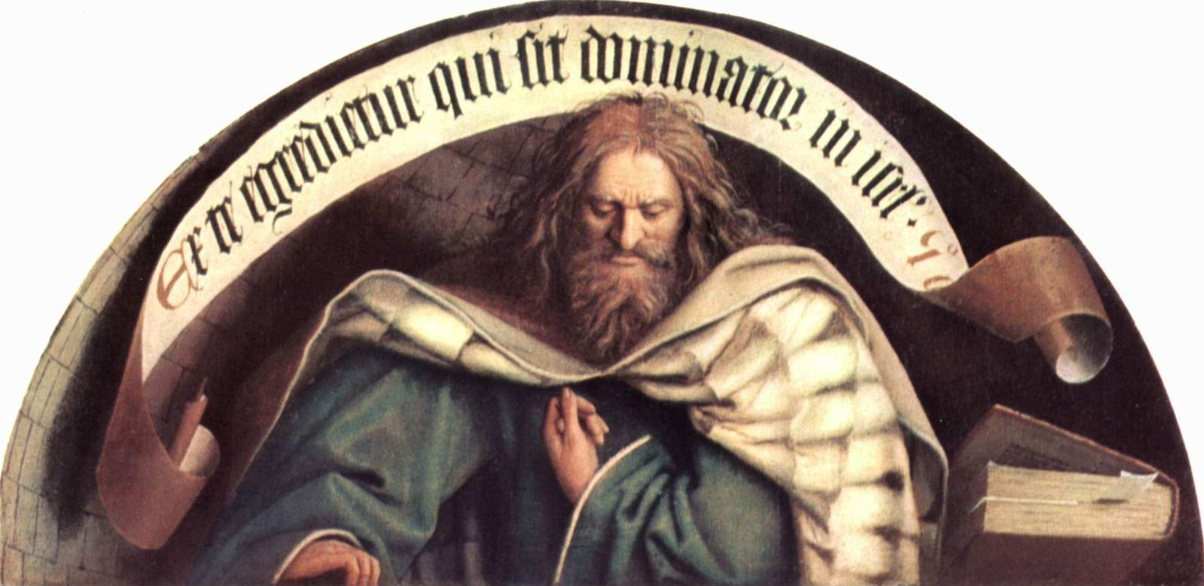
The Prophecies:
But thou, Beth-lehem Ephratah, though thou be little among the thousands of Judah, yet out of thee shall he come forth unto me that is to be ruler in Israel; whose goings forth have been from of old, from everlasting.
[Micah 5:2]

Slide 11
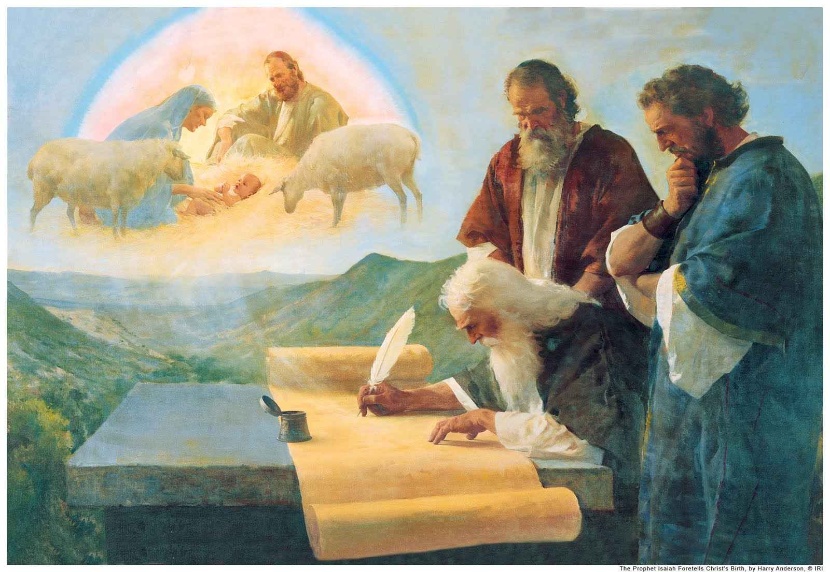
The Prophecies:
Therefore the Lord himself shall give you a sign; Behold, a virgin shall conceive, and shall bear a son, and shall call his name Immanuel.
[Isaiah 7:14]

Slide 12
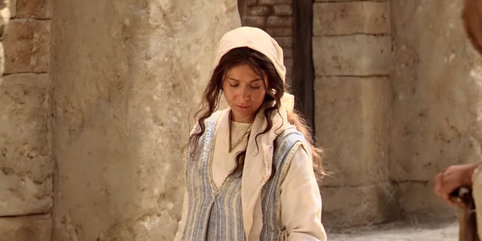
Behold, the virgin whom thou seest is the mother of the
Son of God, after the manner of the flesh.
And it came to pass that I beheld that
she was carried away in the Spirit;
And after she had been carried
away in the Spirit for the space
of a time, the angel spake
unto me, saying, Look!
And I looked and beheld the virgin again,
bearing a child in her arms. And the angel said
unto me, Behold the Lamb of God, yea, even the
Son of the Eternal Father!
I Nephi 3:58-62

Slide 13
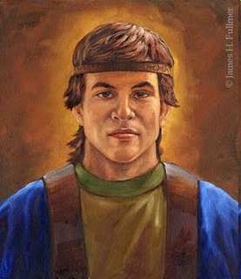
Alma
And behold, he shall be born of Mary at Jerusalem, which is the land of our forefathers, she being a virgin, a precious and chosen vessel, who shall be overshadowed, and conceive by the power of the Holy Ghost, and bring forth a son, yea, even the Son of God; [Alma 5:19]

Slide 14
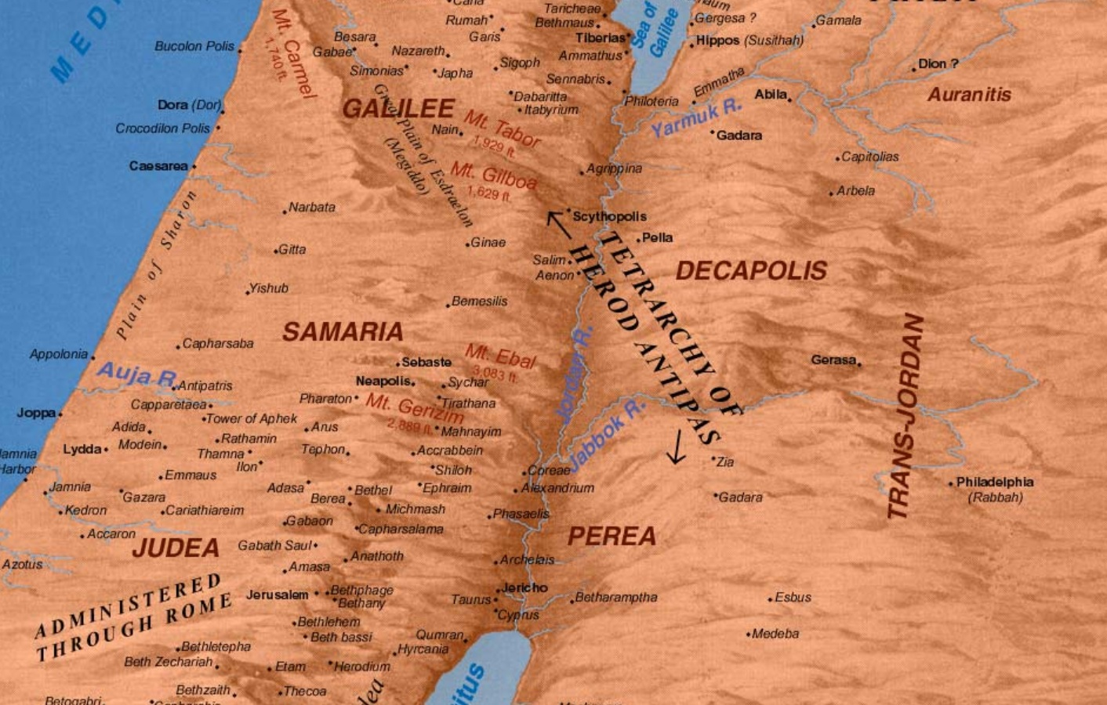
“Land of our forefathers”

Slide 15
…at Jerusalem?
David conquered ancient Jerusalem in approximately 1004 BC and it became known as the City of David.
He brought the Ark of the Covenant to Jerusalem and it became the religious and governmental hub of the United Kingdom of Israel (Judah and Israel).

Slide 16
For unto you is born this day, in the city of David, a Savior, who is Christ the Lord. [Luke 2:11]

Slide 17
And after they had given thanks unto the God of Israel, my father Lehi took the records which were engraven upon the plates of brass, and he did search them from the beginning.
And he beheld that they did contain the five books of Moses, which gave an account of the creation of the world; And also of Adam and Eve, who were our first parents;
And also a record of the Jews from the beginning, even down to the commencement of the reign of Zedekiah, king of Judah; And also the prophecies of the holy prophets, from the beginning, even down to the commencement of the reign of Zedekiah;
And also many prophecies which have been spoken by the mouth of Jeremiah. [1 Nephi 1:158-63]
The Nephites did not have the records of Micah!

Slide 18
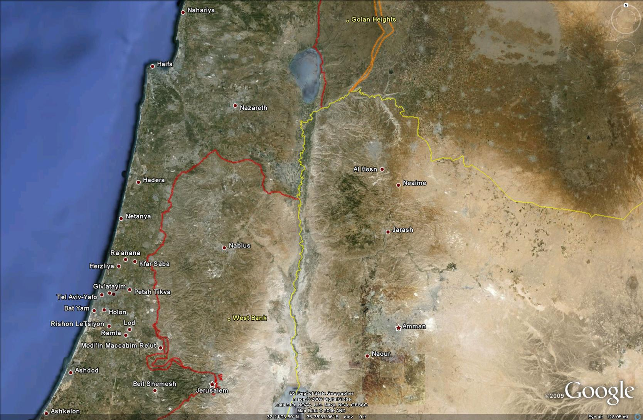
Nazareth
63.5 Miles
Jerusalem

Slide 19
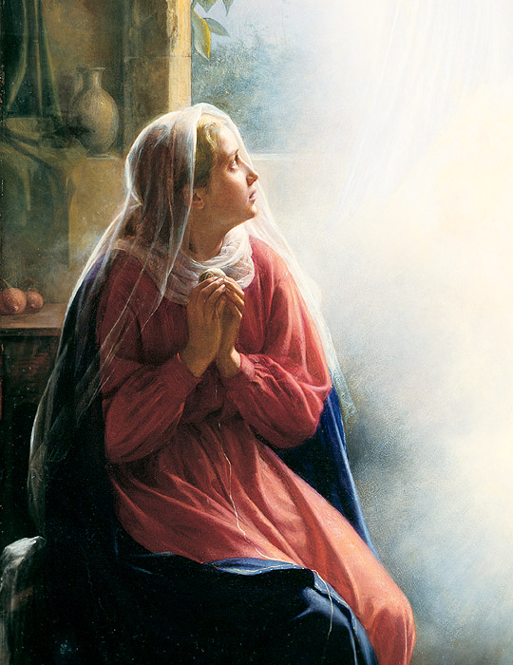
And the angel said unto her, Fear not, Mary, for thou hast found favor with God.
And behold, thou shalt conceive, and bring forth a son, and shall call his name Jesus.
[Luke 1:30-31]

Slide 20
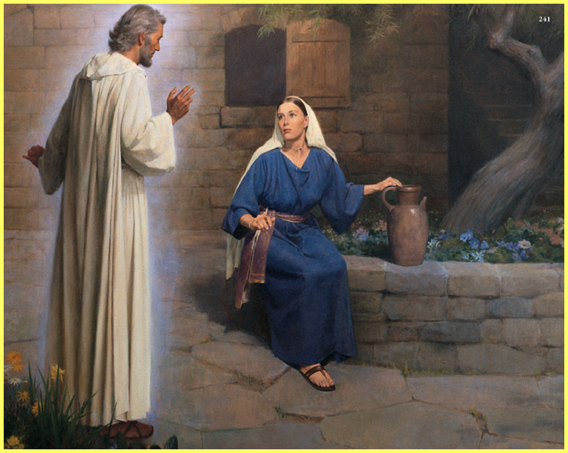
He shall be great, and shall be called the Son of the Highest; and the Lord God shall give unto him the throne of his father David;
[Luke 1:32]

Slide 21
And he shall reign over the house of Jacob forever; and of his kingdom there shall be no end.
[Luke 1:33]

Slide 22
Then said Mary unto the angel; How can this be?
[Luke 1:34]

Slide 23
And the angel answered and said unto her, Of the Holy Ghost, and the power of the Highest. Therefore also, that holy child that shall be born of thee shall be called the Son of God.
[Luke 1:35]

Slide 24
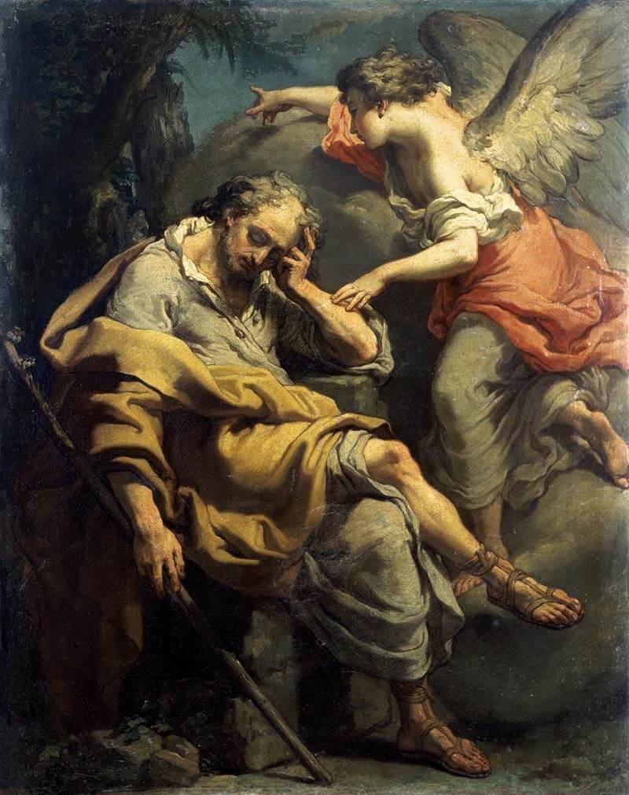
Now, as it is written, the birth of Jesus Christ was on this wise. After his mother, Mary, was espoused to Joseph, before they came together she was found with child of the Holy Ghost. [Matthew 2:1]

Slide 25
Then Joseph, her husband, being a just man, and not willing to make her a public example, was minded to put her away privily.
[Matthew 2:2]

Slide 26
But while he thought on these things, behold, the angel of the Lord appeared unto him in a vision, saying, Joseph, thou son of David, fear not to take unto thee Mary thy wife; for that which is conceived in her, is of the Holy Ghost.
[Matthew 2:3]

Slide 27
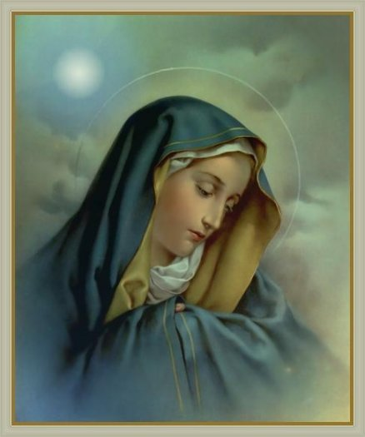
And she shall bring forth a son, and thou shalt call his name Jesus; for he shall save his people from their sins.
Now this took place, that all things might be fulfilled, which were spoken of the Lord, by the prophets, saying,
Behold, a virgin shall be with child, and shall bring forth a son, and they shall call his name Emmanuel, (which, being interpreted, is, God with us.)
Then Joseph, awaking out of his vision, did as the angel of the Lord had bidden him, and took unto him his wife;
And knew her not until she had brought forth her first-born son; and they called his name Jesus.
[Matthew 2:4-8]

Slide 28
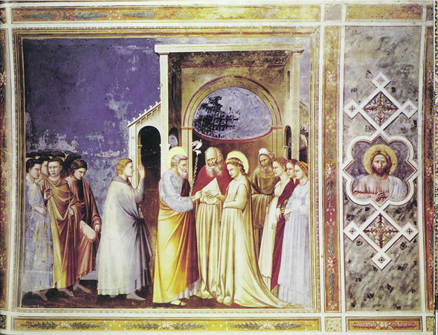
Espoused:
The King James Greek Lexicon
Strong’s Number 718 is Harmozo
Espoused or Harmozo: to betroth a daughter to someone, i.e. to marry the daughter of someone or to give one in marriage.
To break the marriage covenant (betrothal was equivalent to marriage in the ancient world) a bill of divorcement was required. If impurity (any unfaithfulness) was found in the bride, then the bride could be put to death.
http://www.urantia.org/papers/paper83.html

Slide 29
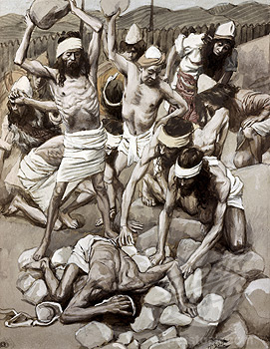
The Betrothal was a serious engagement in the ancient world…And what man is there that hath betrothed a wife, and hath not taken her? let him go and return unto his house, lest he die in the battle, and another man take her. [Deuteronomy 20:7]
If a damsel that is a virgin be betrothed unto a
husband, and a man find her in the city and lie
with her; Then ye shall bring them both out unto
the gate of that city, and ye shall stone them
with stones that they die; the damsel, because
she cried not, being in the city; and the man,
because he hath humbled his neighbor's wife;
so thou shalt put away evil from among you.
[Deuteronomy 22:23-24]
The betrothal could be broken only by a legal transaction (bill of divorcement), and the ground for such termination was fornication. Betrothal lasted for about twelve months, during which the home was to be prepared by the bridegroom.
Ref: preceptaustin.org

Slide 30
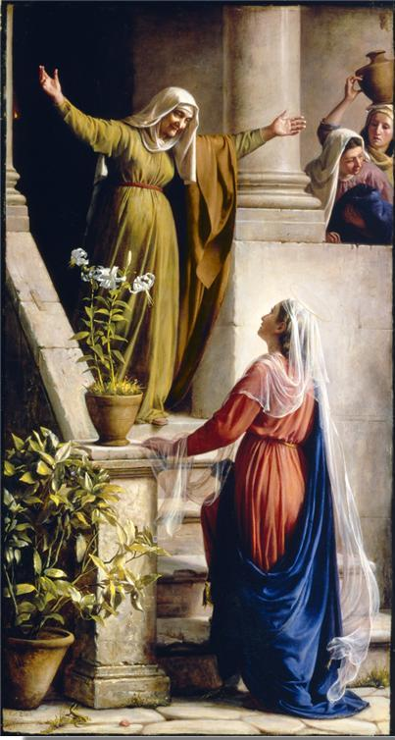
And behold, thy cousin Elizabeth, she hath also conceived a son, in her old age; and this is the sixth month
with her who is called barren.
For with God nothing can be impossible.
And Mary said, Behold the handmaid of the Lord; be it unto me according to thy word. And the angel departed from her.
And in those days, Mary went into the hill country with haste, into a city of Juda,
And entered into the house of Zacharias, and saluted Elizabeth.
And it came to pass, that when Elizabeth heard the salutation of Mary, the babe leaped in her womb.
[Luke 1:36-41]

Slide 31
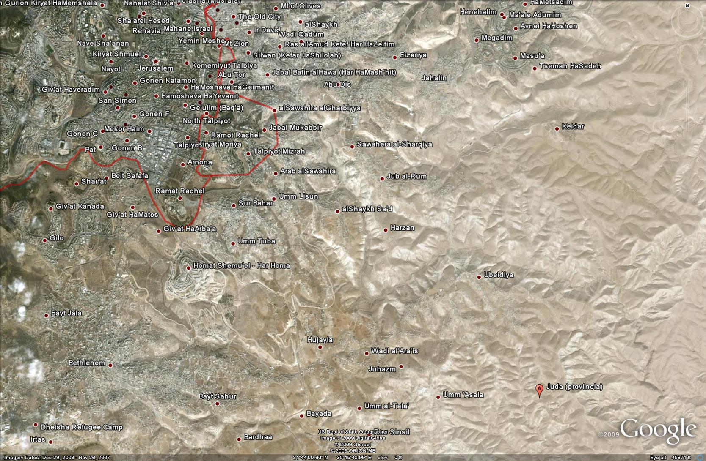
Jerusalem
5.5 Miles
Bethlehem
Juda

Slide 32
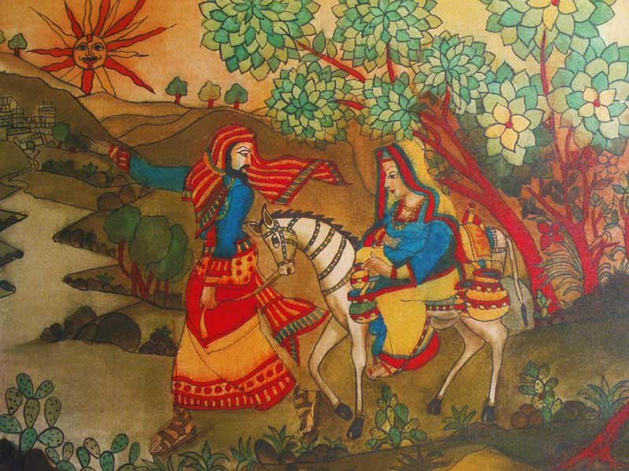
And Mary abode with Elizabeth about three months, and returned to her own house. [Luke 1:55]

Slide 33
Nazareth
Juda
Jerusalem

Slide 34
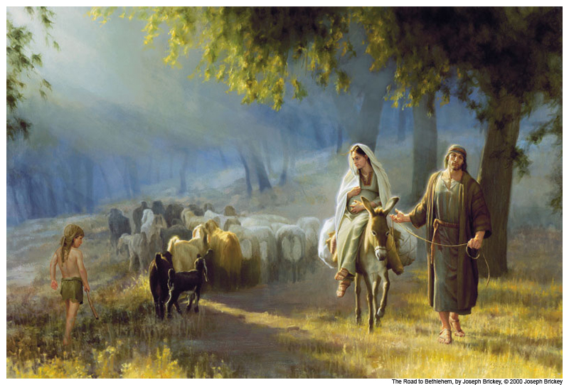
And it came to pass in those days, that there went out a decree from Caesar Augustus, that all his empire should be taxed. This same taxing was when Cyrenius was governor of Syria. (About every 14 years)
And all went to be taxed, every one in his own city.
And Joseph also went up from Galilee, out of the city of Nazareth, into Judea, unto the city of David, which is called Bethlehem; (because he was of the house and lineage of David,)
To be taxed, with Mary his espoused wife, she being great with child.
[Luke 2:1-5]
Do you believe that Joseph would put his nine month pregnant wife on a donkey for 69 miles, or for from about five to ten days and nights?

Slide 35
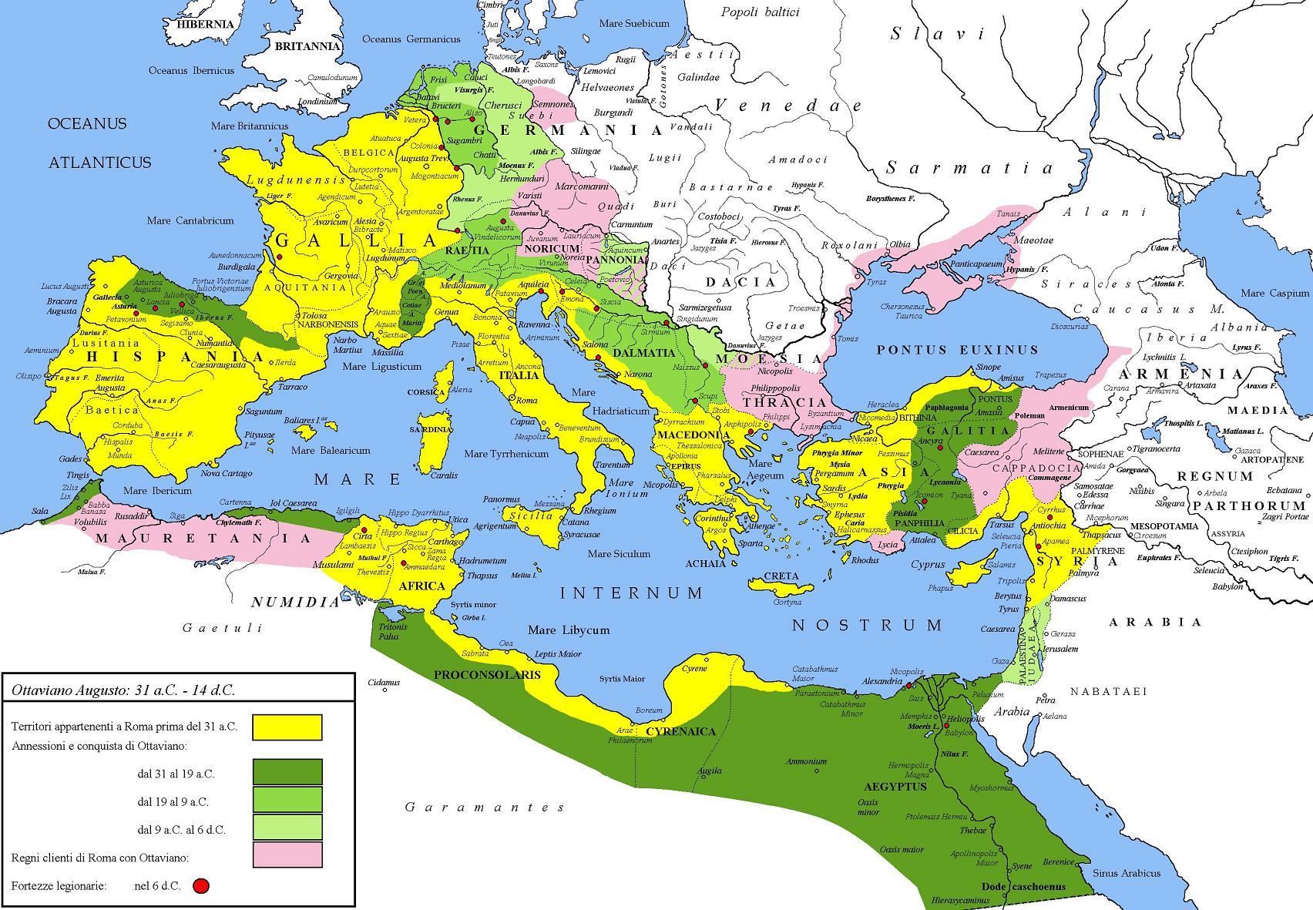
Empire of Caesar Augustus

Slide 36
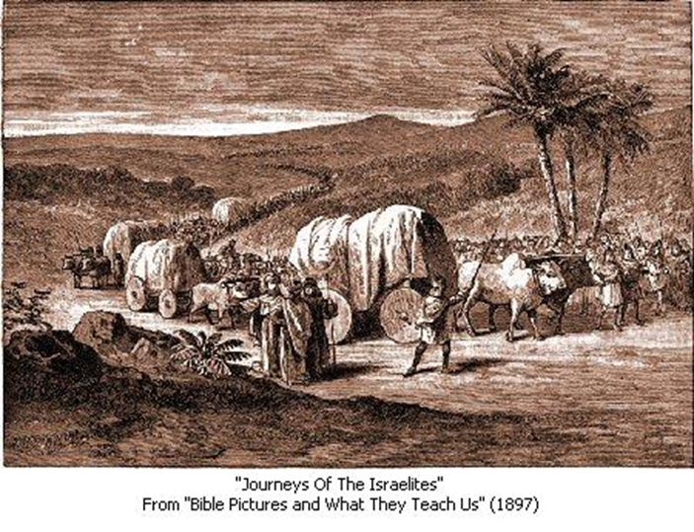
A carpenter in the days of Joseph made products for the local farmers;
yokes shaped from heavy wood as well as forks, rakes, and shovels.
The plows had to be sturdy, for their iron points would be gouging furrows through rocky soil.
Genesis 45 and 46
They also made wooden carts and wagons and crafted both solid and spoked wheels upon which those vehicles rode as well as small wooden toys for the children.
A carpenters occupation also included repairing and maintaining the furniture, tools, and vehicles they made.
“The Carpenter” – Watchtower Online Library

Slide 37
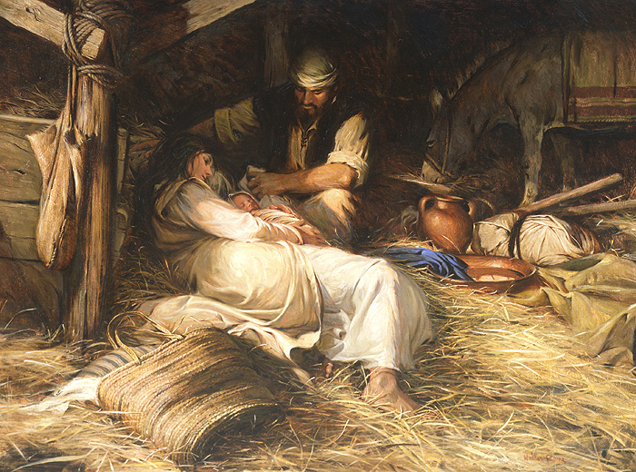
And so it was, that while they were there, the days were accomplished that she should be delivered.
And she brought forth her firstborn son, and wrapped him in swaddling clothes, and laid him in a manger; because there was no room for them in the inn.
[Luke 2:7 KJV]

Slide 38
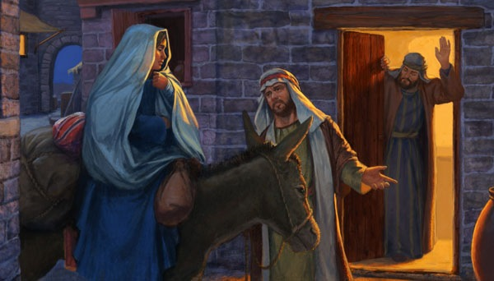
And she brought forth her first-born son, and wrapped him in swaddling clothes, and laid him in a manger, because there was none to give room for them in the inns. [Luke 2:7 I.V.]
WHY?

Slide 39
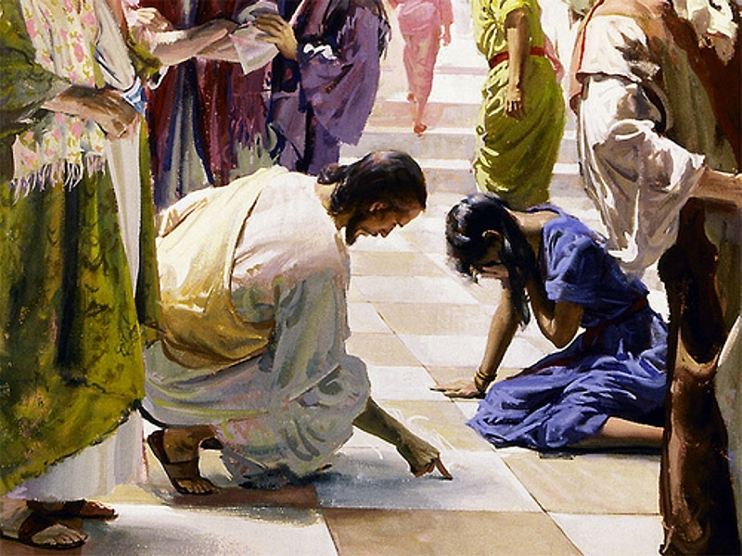
Then said they to him, We be not born of fornication; we have one Father, even God. [John 8:41]

Slide 40
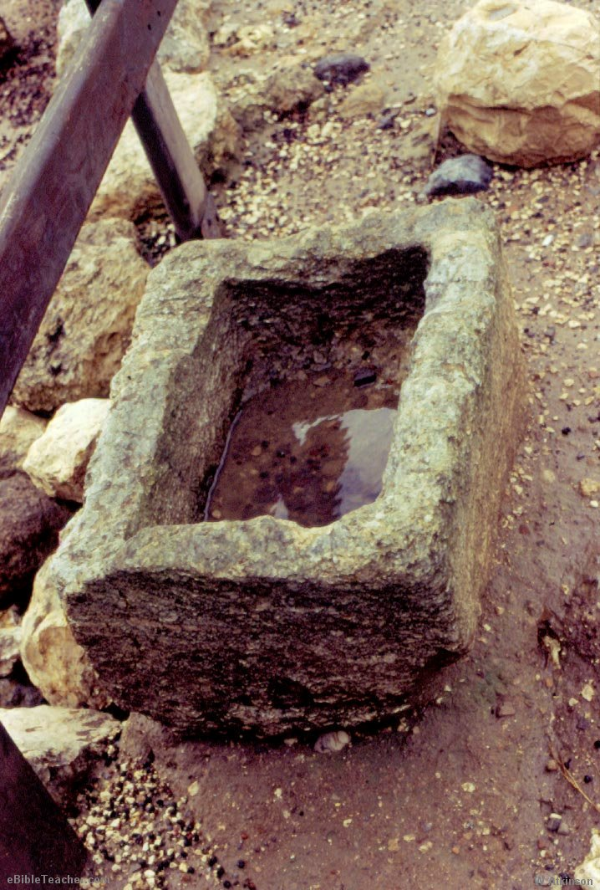
What is a “Manger”?
Manger is the name given to the place where the infant Redeemer was laid. It seems to have been a stall or crib for feeding cattle.
Stables and mangers in our modern sense were in ancient times unknown in the East.
The Greek word here properly denotes "the ledge or projection in the end of the room used as a stall on which the hay or other food of the animals of travelers was placed."
Strong’s Number: 5336

Slide 41
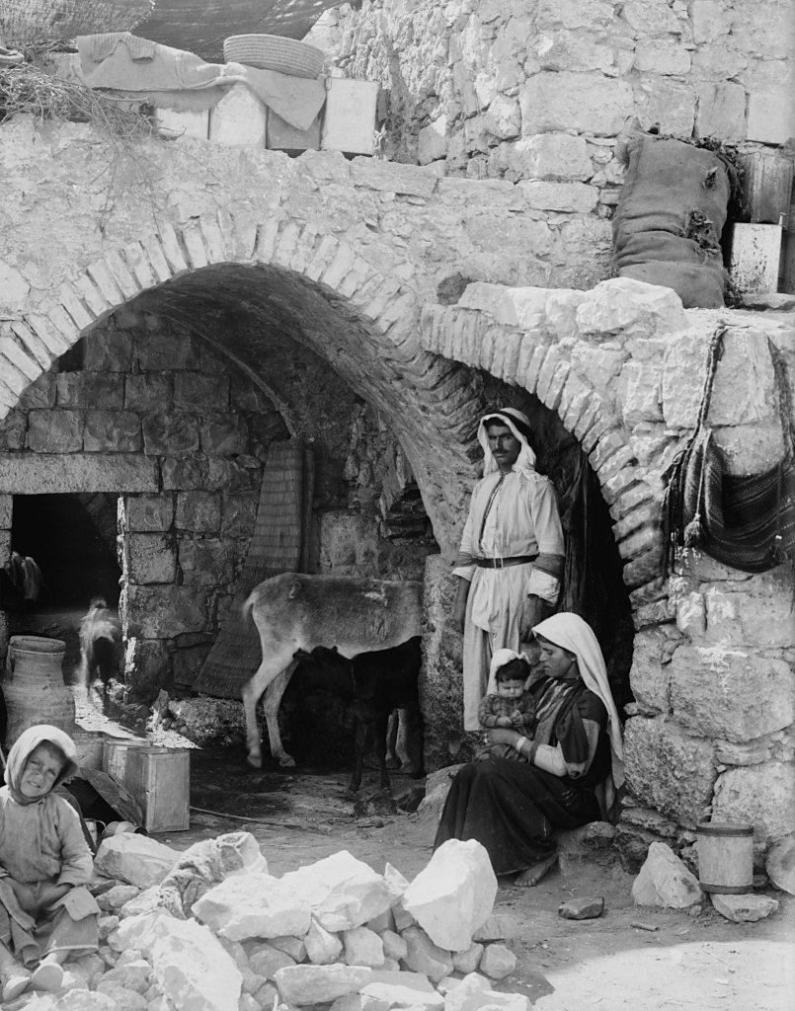
“No Room in the Inns”?
In the typical Christmas presentation, someone will be cast as the heartless innkeeper who refuses to give Joseph and pregnant Mary a room.
However, there is no innkeeper mentioned in the Bible, and the “Inns” are not described.

Slide 42
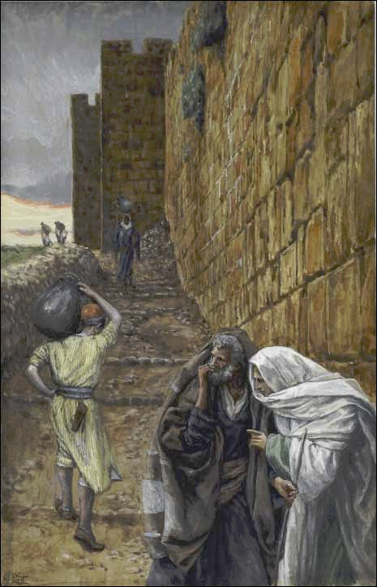
Inn:
The word translated as "inn" is the word kataluma, which is used elsewhere by Luke and translated as "guest chamber" or "upper room“
And he said unto them, Behold, when ye have entered into the city, there shall a man meet you bearing a pitcher of water; follow him into the house where he entereth in.
And ye shall say unto the good man of the house, The Master saith unto you, Where is the guest-chamber, where I shall eat the Passover with my disciples?
And he shall show you a large upper room furnished; there make ready. [Luke 22:10-12]
Kataluma: Guest Chamber / Upper Room…The KJV New Testament Greek Lexicon Strong's Number 2646

Slide 43
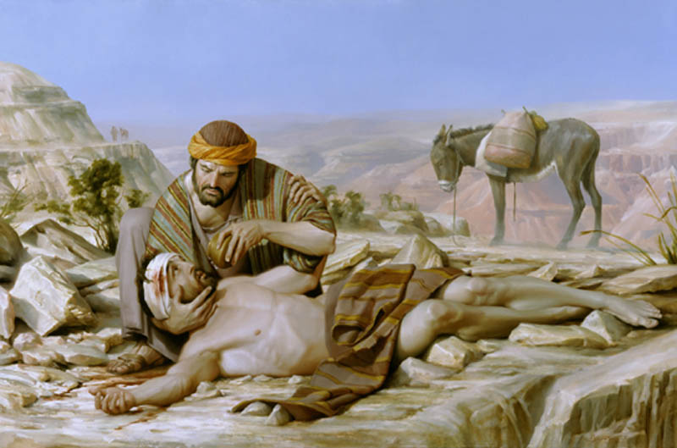
Inn continued:
Luke also uses the Greek word, pandocheion, which speaks of a paid establishment (i.e., an inn), as in the story of the Good Samaritan.
But a certain Samaritan, as he journeyed, came where he was; and when he saw him, he had compassion on him.
And went to him, and bound up his wounds, pouring in oil and wine, and set him on his own beast, and brought him to an inn, and took care of him.
[Luke 10:34-35]
Pandocheion: an inn, a public house for the reception of strangers.
The KJV New Testament Greek Lexicon
Strong’s Number 3829

Slide 44
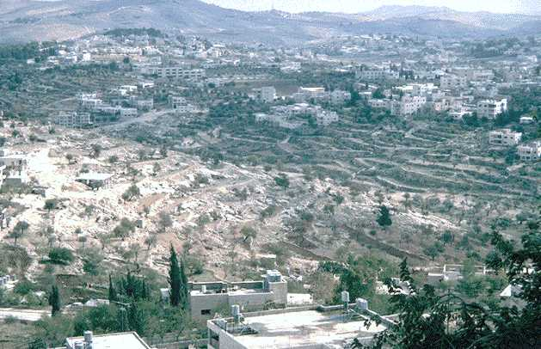
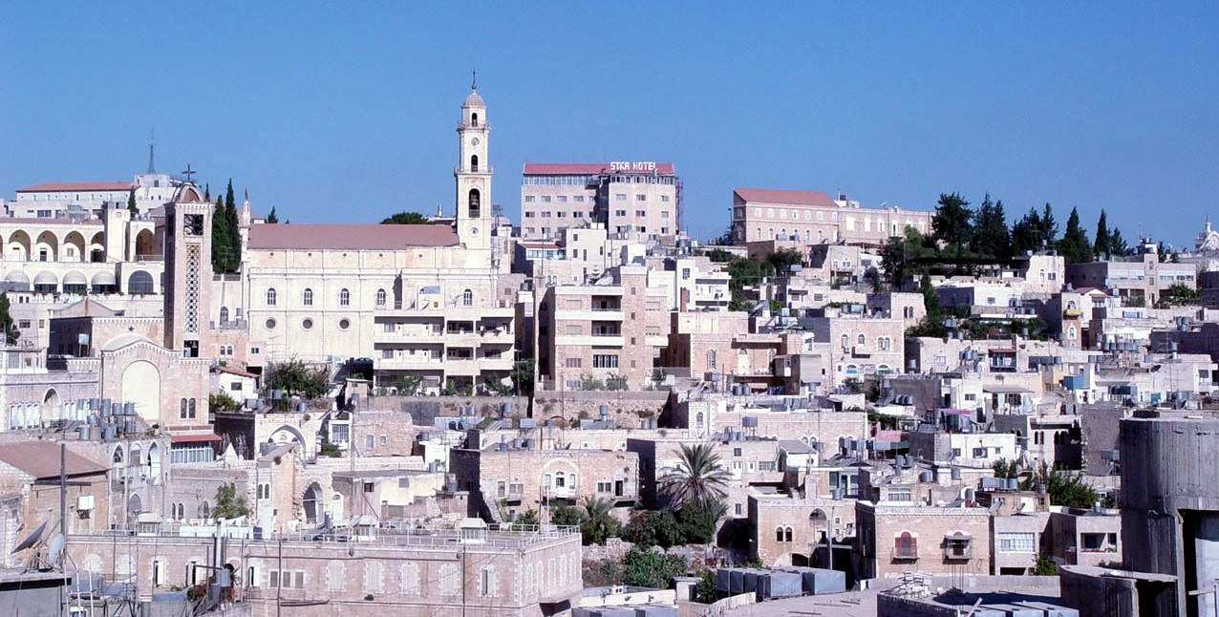
Bethlehem was not on a major trade route so there seems to be little need for public “Inns” or Pandocheions.
The Judean hills are very rugged and are divided by deep wadis (canyons) on the eastern and western slopes. Consequently, travelers have always preferred to stay on ridges, to avoid frequent ascents and descents. For this reason, travelers have moved along the watershed ridge, from the time of Abraham until the present. blog.bibleplaces.com

Slide 45
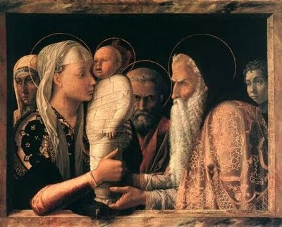
Joseph and Mary were in Bethlehem for the required census.
Joseph had family members who rejected their use of the “guest chambers” or “Inns” because there was no room for an unwed mother.
The birth of Jesus in a room where animals lived reflected this shame and rejection.
And she brought forth her first-born son, and wrapped him in swaddling clothes, and laid him in a manger, because there was none to give room for them in the inns.
[Luke 2:1-7 Inspired Version Only]

Slide 46
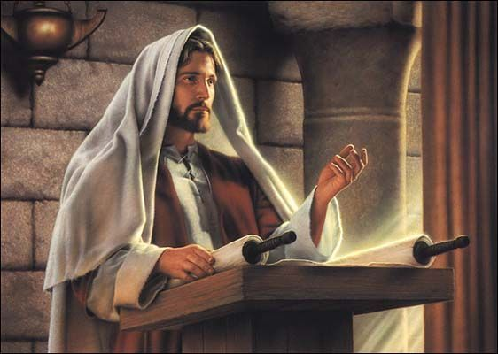
Was their “Fornication?” known?
I know that ye are Abraham's seed; but ye seek to kill me because my
word hath no place in you.
I speak that which I have seen with my Father; and ye do that which ye have seen with your father.
They answered and said unto him, Abraham is our father. Jesus saith unto them, If ye were Abraham's children, ye would do the works of Abraham.
But now ye seek to kill me, a man that hath told you the truth, which I have heard of God; this did not Abraham.
Ye do the deeds of your father. Then said they to him, We be not born of fornication; we have one Father, even God.
Jesus said unto them, If God were your Father, ye would love me; for I proceeded forth and came from God; neither came I of myself, but he sent me. [John 8:37-42]

Slide 47
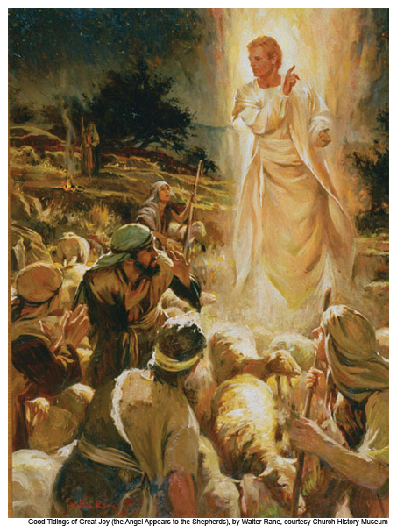
And there were in the same country, shepherds abiding in the field, keeping watch over their flocks by night.
And lo, an angel of the Lord appeared unto them, and the glory of the Lord shone round about them; and they were sore afraid.
[Luke 2:8-9]

Slide 48
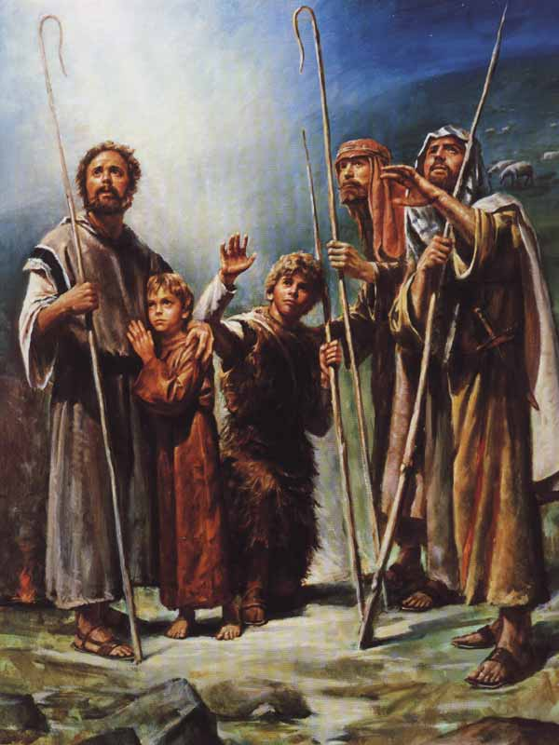
But the angel said unto them, Fear not,
for behold, I bring
you good tidings of
great joy, which shall
be to all people.
For unto you is born this day, in the city of David, a Savior, who is Christ the Lord.
And this is the way you shall find the babe, he is wrapped in swaddling clothes, and is lying in a manger.
[Luke 2:810-12]

Slide 49
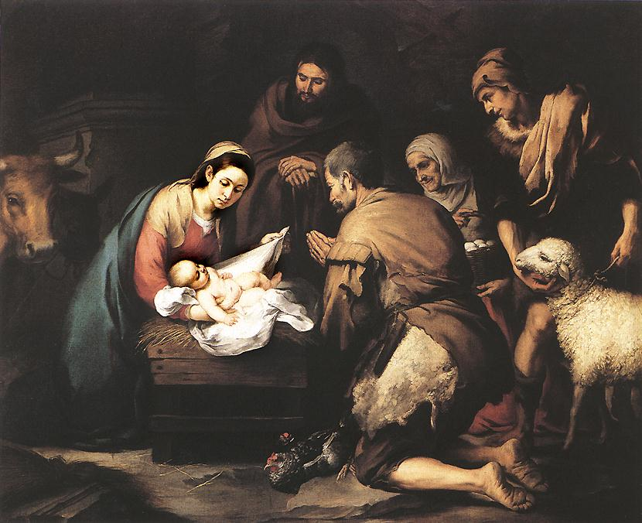
And it came to pass, when the angels
were gone away
from them into heaven, the shepherds said one to another, Let us now go, even unto Bethlehem, and see this thing which is come to pass, which the Lord has made known unto us.
And they came with haste, and found Mary and Joseph, and the babe lying in a manger. [Luke 2:15-16]

Slide 50
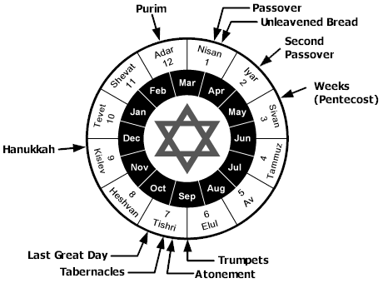
When was Christ born?
April 6, ... is a particularly significant date because it commemorates not only the anniversary of the organization of The Church of Jesus Christ of Latter-day Saints in this dispensation, but is also the possible anniversary of the birth of the Savior, our Lord and Master, Jesus Christ.
The rise of the church of Christ in these last days, being one thousand eight hundred and thirty years since the coming of our Lord and Savior Jesus Christ in the flesh, it being regularly organized and established agreeably to the laws of our country, by the will and commandments of God in the fourth month, and on the sixth day of the month which is called April;
[Sec 17:1a]

Slide 51
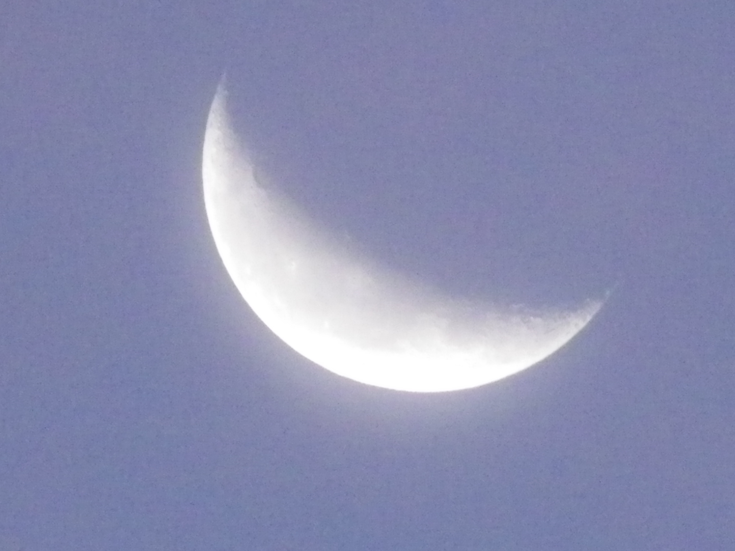
Yea, even six hundred years from the time that my father left Jerusalem, a prophet would the Lord God raise up among the Jews, even a Messiah; or, in other words, a Savior of the world. [1 Nephi 3:4]
And six hundred and nine years had passed away, since Lehi left Jerusalem; and nine years had passed away, from the time when the sign was given, which was spoken of by the prophets, that Christ should come into the world.
Now the Nephites began to reckon their time from this period when the sign was given or from the coming of Christ; [3 Nephi 1:44-45]

Slide 52
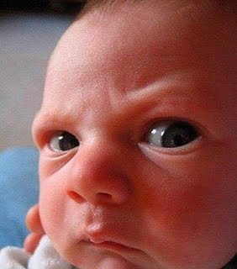
And when eight days were accomplished for the circumcising of the child, his name was called Jesus; which was so named of the angel, before he was conceived. [Luke 2:21]
And the Lord spake unto Moses, saying,
Speak unto the children of Israel, saying, If a woman have conceived seed, and borne a man child, then she shall be unclean seven days; according to the days of the separation for her infirmity shall she be unclean.
And in the eighth day, the man child shall be circumcised.
[Leviticus 12:1-3]

Slide 53
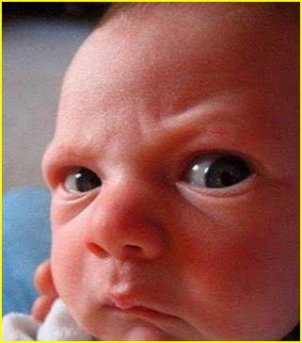
After a day or two of rest Joseph and Mary probably set out for Nazareth some sixty-nine miles away.
Circumstances dictated their choices. A mother could not enter the temple until after forty days following the birth of a male child and it made no practical or economic sense to stay in the “manger” situation for forty days and nights.
The journey would take about five or six days allowing them to arrive home in time for the baby’s circumcision.
The Man Who Circumcised Jesus
By Kenneth Westby

Slide 54
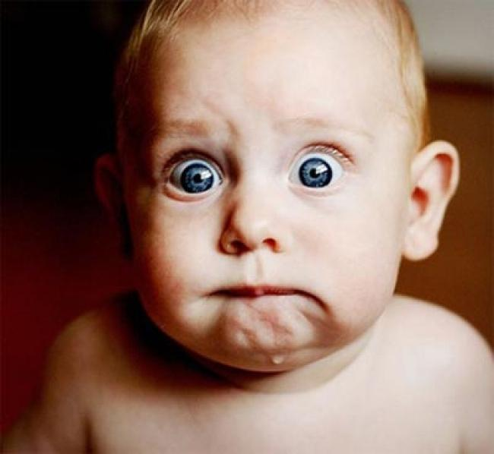
Abraham’s son of promise, Isaac, was circumcised on the eighth day as instructed by God. From that time circumcision became a most important rite in Israel and was carefully honored by the Jews in the days of Jesus.
(Ishmael, Abraham’s other son by handmaid Hagar, was circumcised at age thirteen and to this day Arabs practice circumcision upon their males at age thirteen.)

Slide 55
The circumciser of Jesus is unnamed in Luke’s account.
He may have been a rabbi and many were. Joseph would have known where to contact the nearest circumciser who was a member of a class of respected and important functionaries in Israel.
They bore the title of Mohel and the sacred rite they performed with a sharp knife was called Bris Milah (lit. "Covenant of circumcision"). Originally the command to circumcise was given to the boy’s father but it became custom to delegate that responsibility to a trained and practiced circumciser, the Mohel.

Slide 56
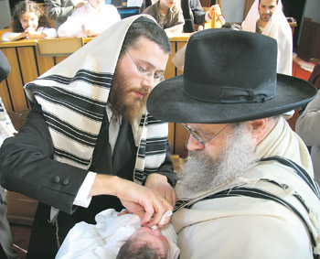
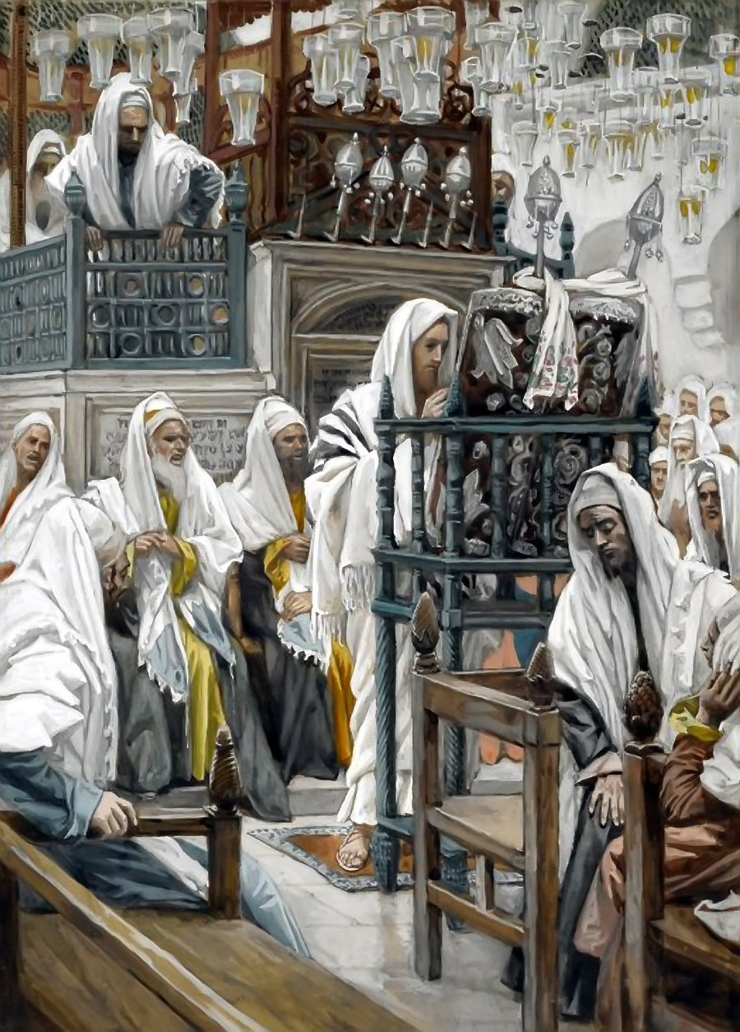
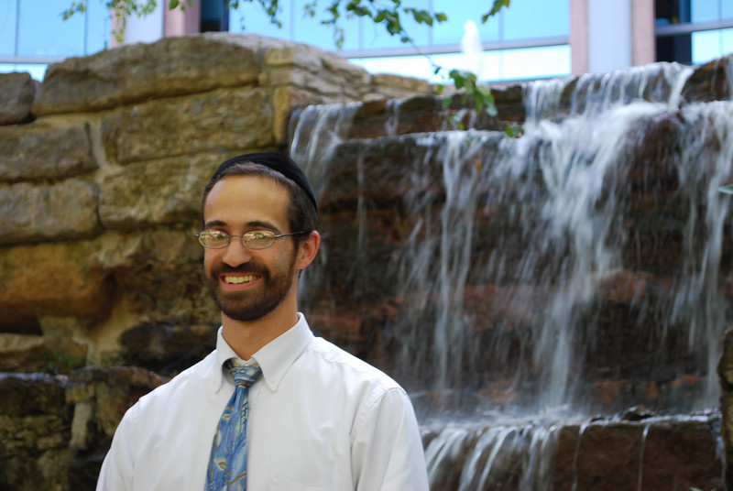
Synagogue of Nazareth
Rabbi Elchanan Schulgasser Certified Mohel of KC - 2020

Slide 57
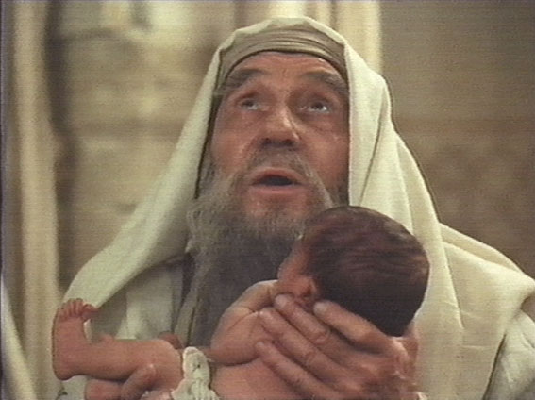
And when the days of her purification,
according to the law of Moses, were accomplished; they brought him to Jerusalem, to present him to the Lord;
As it is written in the law of the Lord, every male which openeth the womb shall be called holy to the Lord;
And to offer a sacrifice according to that which is written in the law of the Lord, A pair of turtle doves, or two young pigeons.
[Luke 2:22-24]

Slide 58
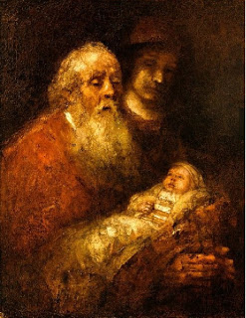
And when the days of her purification, according to the law of Moses, were accomplished; they brought him to Jerusalem, to present him to the Lord; [Luke 2:22]

Slide 59
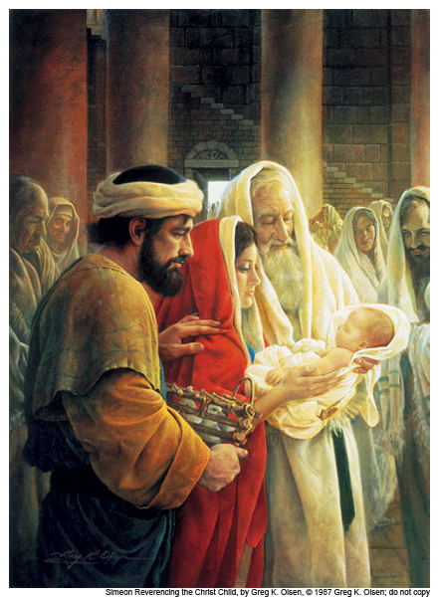
And behold, there was a man at Jerusalem, whose name was Simeon; and the same man was just and devout, waiting for the consolation of Israel; and the Holy Ghost was upon him.
And it was revealed unto him by the Holy Ghost, that he should not see death before he had seen the Lord's Christ.
And he came by the Spirit into the temple; and when the parents brought in the child, even Jesus, to do for him after the custom of the law,
Then took he him up in his arms, and blessed God, and said,
Lord, now lettest thy servant depart in peace, according to thy word;
For mine eyes have seen thy salvation,
Which thou hast prepared before the face of all people;
A light to lighten the Gentiles, and the glory of thy people Israel.
[Luke 2:25-32]

Slide 60
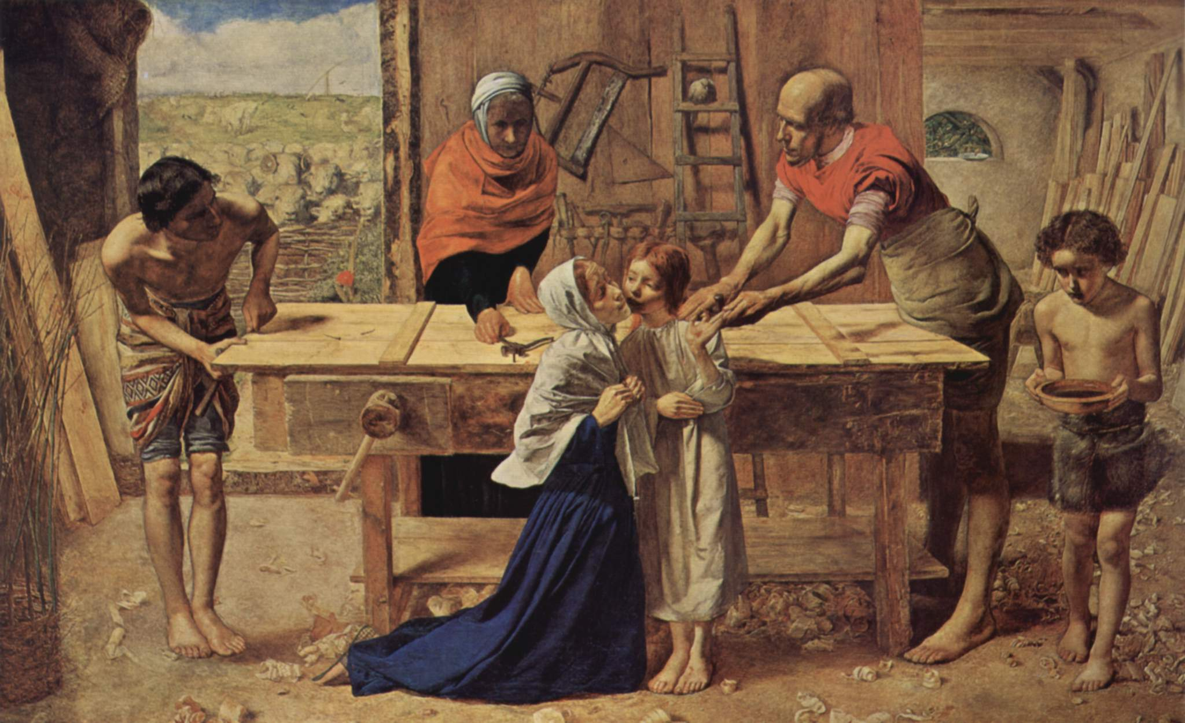
And when they had performed all things according to the law of the Lord, they returned into Galilee to their own city, Nazareth. [Luke 2:39]

Slide 61
Nazareth
Where are the “Wise Men”?
Jerusalem

Slide 62
Did you read anything about us three camels carrying Wise Men?

Slide 63
Ha, Ha, Ha
He, He, He,

Slide 64
Now when Jesus was born in Bethlehem of Judea, in the days of Herod the king, behold, there came wise men from the east to Jerusalem,
Saying, Where is the child that is born, the Messiah of the Jews? for we have seen his star in the east, and have come to worship him. [Matthew 3:1-2]

Slide 68
Who are these “Wise Men” and from where did they come?
When did they come to see Jesus?
How did they know of the birth of Christ …when …where?
What did the “new star” that they saw in the east mean to them?
Why didn’t they just follow the star to the manger?

Slide 69
And after they had given thanks unto the God of Israel, my father Lehi took the records which were engraven upon the plates of brass, and he did search them from the beginning.
And he beheld that they did contain the five books of Moses, which gave an account of the creation of the world;
And also of Adam and Eve, who were our first parents;
[1 Nephi 1:158-160]

Slide 70
And also a record of the Jews from the beginning, even down to the commencement of the reign of Zedekiah, king of Judah; (About 586 BC)
And also the prophecies of the holy prophets, from the beginning, even down to the commencement of the reign of Zedekiah; (About 586 BC)
And also many prophecies which have been spoken by the mouth of Jeremiah. [1 Nephi 1:161-163]
Jeremiah lived during the Babylonian (Chaldean) Empire 625-536 BC.

Slide 71
Zedekiah made King
Prophecies of Jeremiah
But thou, Beth-lehem Ephratah, though thou be little among the thousands of Judah, yet out of thee shall he come forth unto me that is to be ruler in Israel; whose goings forth have been from of old, from everlasting. [Micah 5:2]

Slide 72
We sing the hymn, We Three Kings of Orient Are, which strongly suggest that there were only “Three Wise Men”.

Slide 73
We read novels and poems and stories such as “The Other Wise Man” which give us names such as Casper, Melchoir and Bal-tha-zar. We see movies that depict “Three Wise Men” one of which is dark skinned or black.

Slide 75
When Herod the king had heard of the child, he was troubled, and all Jerusalem with him. And when he had gathered all the chief priests, and scribes of the people together, he demanded of them, saying, Where is the place that is written of by the prophets, in which Christ should be born? For he greatly feared, yet he believed not the prophets.
And they said unto him, It is written by
the prophets, that he should be born in Bethlehem of Judea, for thus have they said,
The word of the Lord came unto us, saying, And thou Bethlehem, which lieth in the land of Judea, in thee shall be born a prince, which art not the least among the princes of Judea; for out of thee shall come the Messiah, who shall save my people Israel.
[Matthew 3:3-6]

Slide 76
Then Herod, when he had called the
wise men privily, inquired of them diligently what time the star appeared.
And he sent them to Bethlehem, and said, Go and search diligently for the young child; and when ye have found the child, bring me word again, that I may come and worship him also. [Matthew 3:7-8]

Slide 77
Who were these “Wise Men”?
Yea, even six hundred years from the time that my father left Jerusalem, a prophet would the Lord God raise up among the Jews, even a Messiah; or, in other words, a Savior of the world.
And he also spake concerning the prophets, how great a number had testified of these things, concerning this Messiah, of whom he had spoken, or this Redeemer of the world.
[1 Nephi 3:4-5]

Slide 78
Who were these “Wise Men”?
For behold, the kingdom of heaven
Is at hand, and the Son of God cometh upon the face of the earth.
And behold, he shall be born of Mary at Jerusalem, which is the land of our forefathers, she being a virgin, a precious and chosen vessel, who shall be overshadowed, and conceive by the power of the Holy Ghost, and bring forth a son, yea, even the Son of God;
[Alma 5:19]

Slide 79
And behold, he [Samuel, the Lamanite] said unto them, Behold, I give unto you a sign: for five years more cometh, and behold, then cometh the Son of God to redeem all those who shall believe on his name.
And behold, this will I give unto you for a sign at the time of his coming; for behold, there shall be great lights in heaven, insomuch that in the night before he cometh, there shall be no darkness, insomuch that it shall appear unto man as if it was day;
Therefore there shall be one day and a night, and a day, as if it were one day, and there were no night; and this shall be unto you for a sign; for ye shall know of the rising of the sun, and also of its setting;
Therefore they shall know of a surety that there shall be two days and a night; nevertheless the night shall not be darkened; and it shall be the night before he is born.
[Helaman 5:55-58]

Slide 80
And behold there shall be a new star arise, such an one as ye never have beheld; and this also shall be a sign unto you.
And behold this is not all, there shall be many signs and wonders in heaven.
And it shall come to pass that ye shall all be amazed, and wonder, insomuch that ye shall fall to the earth.
And it shall come to pass that whosoever shall believe on the Son of God, the same shall have everlasting life.
[Helaman 5:59-62]

Slide 81
And angels did appear unto men, wise men, and did declare unto them glad tidings of great joy; thus in this year the scriptures began to be fulfilled.
[Helaman 5:126]

Slide 82
WHO WERE THESE “WISE MEN”?
And behold, the people did rejoice,
and glorify God, and the whole face
of the land was filled with rejoicing;
and they did no more seek to
destroy Nephi, but they did esteem
him as a great prophet, and a man
of God, having great power and
authority given unto him from God.
And behold, Lehi, his brother, was not a whit behind him as to things pertaining to righteousness.
[Helaman 4:22-23]

Slide 83
WHO WERE THESE “WISE MEN”?
And as they went forth to lay their hands on him (Samuel, the Lamanite), behold, he did cast himself down from the wall, and did flee out of their lands, yea, even unto his own country, and began to preach and to prophesy among his own people. [Helaman 5:119]

Slide 84
WHO WERE THESE “WISE MEN”?
And behold, he was never heard of more among the Nephites; and thus were the affairs of the people.
[Helaman 5:120]
Samuel, the Lamanite

Slide 85
WHO WERE THESE “WISE MEN”?
And Nephi, the son of Helaman, had departed out of the land of Zarahemla, giving charge unto his son Nephi, who was his eldest son, concerning the plates of brass, and all the records which had been kept, and all those things which had been kept sacred, from the departure of Lehi out of Jerusalem;
Then he departed out of the land, and whither he went, no man knoweth; and his son Nephi did keep the record in his stead, yea, the record of this people. [3 Nephi 1:2-3]

Slide 86
WHO WERE THESE “WISE MEN”?
Therefore, nine years had passed away, and Nephi, who was the father of Nephi, who had the charge of the records, did not return to the land of Zarahemla, and could nowhere be found in all the land. [3 Nephi 1:46]

Slide 87
And as they went forth to lay their hands on him [Samuel, the Lamanite], behold, he did cast himself down from the wall, and did flee out of their lands, yea, even unto his own country, and began to preach and to prophesy among his own people.
And behold, he was never heard of more among the Nephites; and thus were the affairs of the people.
[Helaman 5:119-120]

Slide 88
And it came to pass that he [Nephi the son of Nephi] cried mightily unto the Lord, all that day; and behold, the voice of the Lord came unto him, saying, Lift up your head and be of good cheer, for behold, the time is at hand, and on this night shall the sign be given,
And on the morrow come I into the world, to shew unto the world that I will fulfill all that which I have caused to be spoken by the mouth of my holy prophets.
[3 Nephi 1:12-13]

Slide 89
Therefore, nine years had passed away, and Nephi, who was the father of Nephi, who had the charge of the records, did not return to the land of Zarahemla, and could nowhere be found in all the land.
[3 Nephi 1:46]

Slide 90
Where the “Wise Men” Magi or Astrologers?
And lest thou lift up thine eyes unto heaven, and when thou seest the sun, and the moon, and the stars, even all the host of heaven, shouldest be driven to worship them, and serve them, which the Lord thy God hath divided unto all nations under the whole heaven. [Deuteronomy 4:19]
If there be found among you, within any of thy gates which the Lord thy God giveth thee, man or woman, that hath wrought wickedness in the sight of the Lord thy God, in transgressing his covenant, And hath gone and served other gods, and worshiped them, either the sun, or moon, or any of the host of heaven, which I have not commanded;
And it be told thee, and thou hast heard of it, and inquired diligently, and, behold, it be true, and the thing certain, that such abomination is wrought in Israel;
Then shalt thou bring forth that man or that woman, which have committed that wicked thing, unto thy gates, even that man or that woman, and shalt stone them with stones, till they die,… [Deuteronomy 17:2-5]

Slide 91
Thou art wearied in the multitude of thy counsels. Let now the astrologers, the stargazers, the monthly prognosticators, stand up, and save thee from these things that shall come upon thee.
Behold, they shall be as stubble; the fire shall burn them; they shall not deliver themselves from the power of the flame;…
[Isaiah 47:1-14]

Slide 92
The Greek word "Magoi" in Matthew 3:1-12 is transliterated into English as "Magi" or translated as "wise men". Strong’s number 3097
Then the king made Daniel a great man, and he gave him many great gifts, and made him ruler over the whole province of Babylon, and chief of the governors over all the wise men of Babylon. [Daniel 2:48]

Slide 93
O Belteshazzar, master of the magicians, because I know that the spirit of the holy gods is in thee, and no secret troubleth thee, tell me the visions of my dream that I have seen, and the interpretation thereof. [Daniel 4:9]
There is a man in thy kingdom, in whom is the spirit of the holy gods; and in the days of thy father light and understanding and wisdom, like the wisdom of the gods, was found in him; whom the king Nebuchadnezzar thy father, the king, I say, thy father, made master of the magicians, astrologers, Chaldeans, and soothsayers;
Forasmuch as an excellent spirit, and knowledge, and understanding, interpreting of dreams, and showing of hard sentences, and dissolving of doubts, were found in the same Daniel, whom the king named Belteshazzar; now let Daniel be called, and he will show the interpretation. [Daniel 5:11-12]

Slide 94
Magoi had the authority to choose someone as king over the Parthian empire, which was every bit an equal to the Roman empire.
It's little wonder that when the Magoi showed up asking about a king… "When King Herod heard this he was disturbed, and all Jerusalem with him."
Three ordinary astrologists strolling into Jerusalem on camels would not even disturb King Herod's lowest bodyguard, much less the whole city of Jerusalem.
The arrival of these “Wise Men” got Herod’s attention!
Ref: Parthia.com

Slide 95
Parthian Empire
Jerusalem

Slide 96
The Parthian Empire is a fascinating period of Persian history closely connected to Greece and Rome.
Ruling from 247 B.C. to A.D. 228 in ancient Persia (Iran), the Parthians defeated Alexander the Great's successors, the Seleucids, conquered most of the Middle East and southwest Asia, controlled the Silk Road and built Parthia into an Eastern superpower.
The Parthian empire revived the greatness of the Achaemenid empire and counterbalanced Rome's hegemony in the West.
Parthia at one time occupied areas now in Iran, Iraq, Turkey, Armenia, Georgia, Azerbaidzhan, Turkmenistan, Afghanistan, Tajikistan, Pakistan, Syria, Lebanon, Jordan, Palestine and Israel.

Slide 97
Parthian Empire

Slide 98
The Magoi were still influential in the Parthian empire at the birth of Christ. The Parthian empire was ruled by kings.
But there was also a governing body, the Megistanes, which means "the great ones" or "lords". The Megistanes consisted of the Sophoi and the Magoi (or Sophi and Magi). They had great wealth and knowledge.
It is very interesting to note that the Magoi were responsible for choosing the kings of the great Parthian empire. They had an unusual amount of power and control for an eastern monarchy in which they were not the absolute kings. In fact, there is a sense they were like kings or lords in terms of power.
Little wonder that some of the words or songs written about them over the centuries has referred to them as "kings". Their power was in fact only exceeded by the absolute kings themselves. Ref: Parthia.com

Slide 99
From the Jewish historian Josephus, the Greek historian Herodotus, and the writings of Strabo, a clearer picture of the people called the magi appears.
The magi first appear in history in about the 7th century B.C. in the Median empire (Herodotus I, ci). It is possible that we see examples of them in Daniel 2 and Jeremiah 39.
At the time of the birth of Jesus they were an ancient priestly caste dwelling within the Parthian empire that practiced astrology (note: at this time, "astrology" was a hybrid of astrology and what we now call astronomy). They were adept at interpreting dreams (which we possibly get a flavor of as early as Daniel 2). Also at the time just prior to the birth of our Lord, the magi formed the upper house of the council of the Megistanes, whose duties included the election of the king of the Parthian empire (Strabo, XI, ix, 3). Thus, the magi at this time were very possibly "king makers."
(Sources: D. W. Jayne, "Magi," The Zondervan Pictorial Encyclopedia of the Bible, vol. 4:31-34; Josephus, Antiquities of the Jews and The Jewish War; Herodotus, The History of Herodotus; A. Holmstead, History of the Persian Empire).

Slide 100
When did the wise men begin to follow the star?
Did the star, which the wise men followed, lead them to Bethlehem?

Slide 101
We see many pictures and Christmas cards depicting the star shining over Bethlehem.

Slide 102
When they had heard the king, they departed; and lo, the star which they saw in the east, went before them, until it came and stood over where the young child was.
[Where was the young child?]
When they saw the star, they rejoiced with exceeding great joy. [Matthew 3:9-10]

Slide 103
And when they were come into the house, they saw the young child, with Mary his mother, and fell down and worshiped him.
And when they had opened their treasures, they presented unto him gifts; gold, and frankincense, and myrrh.
[Matthew 3:11]

Slide 104
And being warned of God in a dream that they should not return to Herod, they departed into their own country another way.
[Matthew 3:12]

Slide 105
And when they were departed, behold, the angel of the Lord, appeared to Joseph in a vision, saying, Arise and take the young child and his mother, and flee into Egypt, and tarry thou there until I bring thee word; for Herod will seek the young child to destroy him.
And then he arose, and took the young child, and the child's mother, by night, and departed into Egypt;
And was there until the death of Herod, that it might be fulfilled which was spoken of the Lord, by the prophet, saying, Out of Egypt have I called my Son.
[Matthew 3:13-15]
When Israel was a child, then I loved him, and called my son out of Egypt. [Hosea 11:1]

Slide 106
Nazareth
Egypt

Slide 107
Then Herod, when he saw that he was mocked of the wise men, was exceeding wroth; and sent forth and slew all the children that were in Bethlehem, and all the coasts thereof, from two years old and under, according to the time which he had diligently inquired of the wise men.
[Matthew 3:16]

Slide 108
Behold I have given unto you my gospel, and this is the gospel which I have given unto you, that I came into the world to do the will of my Father, because my
Father sent me;
And my Father sent me that I might be lifted up upon the cross; and after that I
had been lifted up upon the cross, I might draw all men unto me:
That as I have been lifted up by men, even so should men be lifted up by the Father, to stand before me, to be judged of their works, whether they be good or whether they be evil;
And for this cause have I been lifted up; therefore, according to the power of the Father, I will draw all men unto me, that they may be judged according to their works.
And it shall come to pass, that whoso repenteth and is baptized in my name, shall be filled; and if he endureth to the end, behold, him will I hold guiltless before my Father, at that day when I shall stand to judge the world.
[III Nephi 12:12-29]

Slide 110
Now, verily I say unto you, that through the redemption which is made for you, is brought to pass the resurrection from the dead. And the spirit and the body is the soul of man.
And the resurrection from the dead is the redemption of the soul; and the redemption of the soul is through him who quickeneth all things, in whose bosom it is decreed, that the poor and the meek of the earth shall inherit it.
[Sec 85:4a-4b]

Slide 111
Who is Kriss Kringle?
Who’s Hair is as White
as snow and garments
are red like wine?
Who works in a carpenter shop and makes toys for the little children?

Slide 113
Jesus said, Suffer little children to come unto me, and forbid them not, for of such is the kingdom of heaven. [Matthew 19:14]

Slide 114
And he laid hands on them, and departed thence. [Matthew 19:15]

Slide 115
His head and his hairs were white like wool, as white as snow; [Revelation 1:14]

Slide 116
Wherefore art thou red in thine apparel, and thy garments like him that treadeth in the winefat?
I have trodden the winepress alone; and of the people there was none with me: for I will tread them in mine anger, and trample them in my fury; and their blood shall be sprinkled upon my garments, and I will stain all my raiment.
[Isaiah 63:2]

Slide 117
Be ye therefore ready also: for the Son of man cometh at an hour when ye think not. [Luke 12:40]
Take ye heed, watch and pray: for ye know not when the time is. [Mark 13:33]

Slide 118
Is not this the carpenter, the son of Mary, the brother of James and Joses, and of Judah and Simon? [Mark 6:4]

Slide 119
But of that day and hour no one knoweth; no, not the angels of God in heaven, but my Father only. [Matthew 24:43]
Who’s coming to town?

Slide 120
Jesus
Is
Coming
To
Town!

Slide 121
Omnipotent
I can deliver all the toys in the world in one night!
Unlimited power and authority

Slide 122
Omniscience
Knows everything
I know if you’ve been…

Slide 123
Omnipresence
The attribute of God by which He fills the universe in all its parts and is present everywhere at once.
He sees when you’re sleeping. He knows when you’re awake. He knows if you’ve been bad or good. So be good for …

Slide 124
He sees you when you’re sleeping. He knows when you’re awake. He knows if you’ve been bad or good. So be good for goodness sake!

Slide 125
He's making a list And checking it twice; Gonna find out Who's naughty and nice Santa Claus is coming to town.

Slide 127
But unto the son he saith, Thy throne, O God, is forever and ever; a scepter of righteousness is the scepter of thy kingdom. [Hebrews 1:8]

Slide 128
Children, obey your parents in the Lord; for this is right. [Ephesians 6:1]
Santa tells children to obey their parents.

Slide 129
But Jesus said, Suffer little children to come unto me, and forbid them not, for of such is the kingdom of heaven.
[Matthew 19:14]

Slide 130
Kris Kringle Country of Origin: Germany & America
The figure of Santa Claus first begins to show up among the Pennsylvania Dutch in the mid 1820s in the form of Kris Kringle, or as he was also known, Belsnickle. Belsnickle is a derivative of the German "Pelz-nickle", which means "Nicholas in Furs ".
Belsnickle would travel the Pennsylvania countryside ringing his bell looking for good children to give out his small gifts of cakes and nuts. If Belsnickle came across a child who had not been behaving in the past year, he would warn the child to be good or else he might give them a smack with his rod.

Slide 131
Word Origin & History
Kriss Kringle
1830, Christ-kinkle (in a Pennsylvania German context), from Ger. Christkindlein, Christkind'l "Christ child."
Properly Baby Jesus, not Santa Claus.
Online Etymology
http://dictionary.reference.com/browse/kriss kringle

Slide 132
Ho, ho, come forth, and flee from the land of the north, saith the Lord: for I have spread you abroad as the four winds of the heaven, saith the Lord. [Zechariah 2:6]
Look
For
Me,
I’m
Coming
From The North!
Zechariah
Ho, ho, ho!

Slide 134
You better watch out
You better not cry
Better not pout
I'm telling you why
Santa Claus is coming to town?
You better watch out You better not cry Better not pout I'm telling you why Santa Claus is coming to town

Slide 135
Who is coming
to town?
And they shall see the Son of Man
coming in the clouds of heaven, with
power and great glory.
And whoso treasureth up my words,
shall not be deceived.
For the Son of Man shall come, and
he shall send his angels before him with the great sound of a trumpet, and they shall gather together the remainder of his elect from the four winds; from one end of heaven to the other. [Matthew 24:38-40]

Slide 136
Who is coming to town?
And he said, The time draweth near, and therefore take heed that ye be not deceived; for many shall come in my name, saying, I am Christ; go ye not therefore after them. [Luke 21:8]
And ye shall be betrayed both by parents, and brethren, and kinsfolk, and friends; [Luke 21:15]
And ye shall be hated of all the world for my name's sake. [Luke 21:16]

Slide 137
Who is coming to town?
And then shall they see the Son of Man coming in a cloud, with power and great glory. [Luke 21:28]

Slide 138
Who is coming to town?
Let my disciples therefore take heed to themselves, lest at any time their hearts be overcharged with surfeiting, and drunkenness, and cares of this life, and that day come upon them unawares.
For as a snare it shall come on all them who dwell on the face of the whole earth.
And what I say unto one, I say unto all, Watch ye therefore, and pray always, and keep my commandments, that ye may be counted worthy to escape all these things which shall come to pass, and to stand before the Son of Man when he shall come clothed in the glory of his Father. [Luke 21:34-36]

Slide 139
Jesus is coming to town!
Teach your children to WATCH FOR HIM!

Slide 141
Thank You and may the Lord bless you and your family during this Christmas Season.
Seventy James L. Noland

Slide 142
[Jeremiah 10:2] Thus saith the Lord, Learn not the way of the heathen, and be not dismayed at the signs of heaven; for the heathen are dismayed at them.
[Jeremiah 10:3] For the customs of the people are vain; for one cutteth a tree out of the forest, the work of the hands of the workman, with the axe.
[Jeremiah 10:4] They deck it with silver and with gold; they fasten it with nails and with hammers, that it move not.

Slide 143
Oh Christmas tree, Oh Christmas tree!
Thy leaves are so unchanging
Oh Christmas tree, Oh Christmas tree,
Thy leaves are so unchanging
Not only green when summer's here,
But also winters cold and drear.
Oh Christmas tree, Oh Christmas tree,
Thy leaves are so unchanging!
Oh Christmas tree, Oh Christmas tree,
Much pleasure do you bring me!
Oh Christmas tree, Oh Christmas tree,
Much pleasure do you bring me!
For every year the Christmas tree,
Brings to us all both joy and glee.
Oh Christmas tree, Oh Christmas tree,
Much pleasure do you bring me!
Oh Christmas tree, Oh Christmas tree,
You'll never be unchanging!
A symbol of good, will, and love
You'll never be unchanging
Each shining light
Each silver bell
No one alive spreads cheer so well
Oh Christmas tree, Oh Christmas tree,
You'll never be unchanging

Slide 144
Keep
Christ
in Christmas
By
Seventy
James L. Noland

